Slide 1
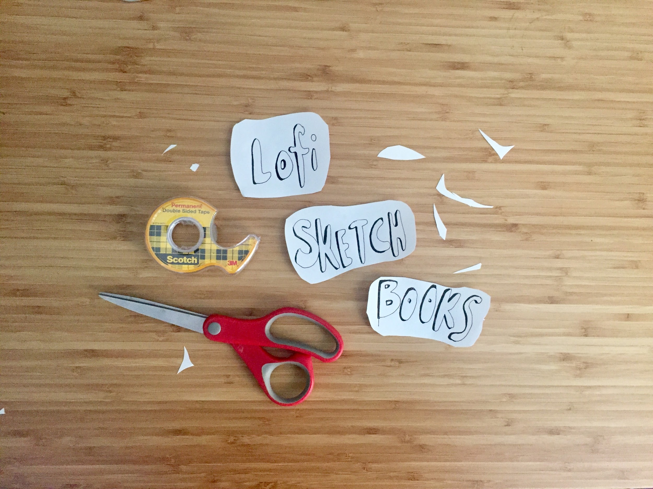
Teaching As Art Day!
Class: Lofi Sketchbooks
Teacher: Becca Moore
Room: 613
Notes:
Welcome to Lofi sketchbooks!
My name is Becca & today we’ll take a look at 2 types of quick book formats from 8.5” x 11.5” sheets of printer paper & tape. You can create these formats with a diverse range of materials. If you love watercolor and ink you may think about creating an accordion fold out of water color paper & chipboard.

Slide 2
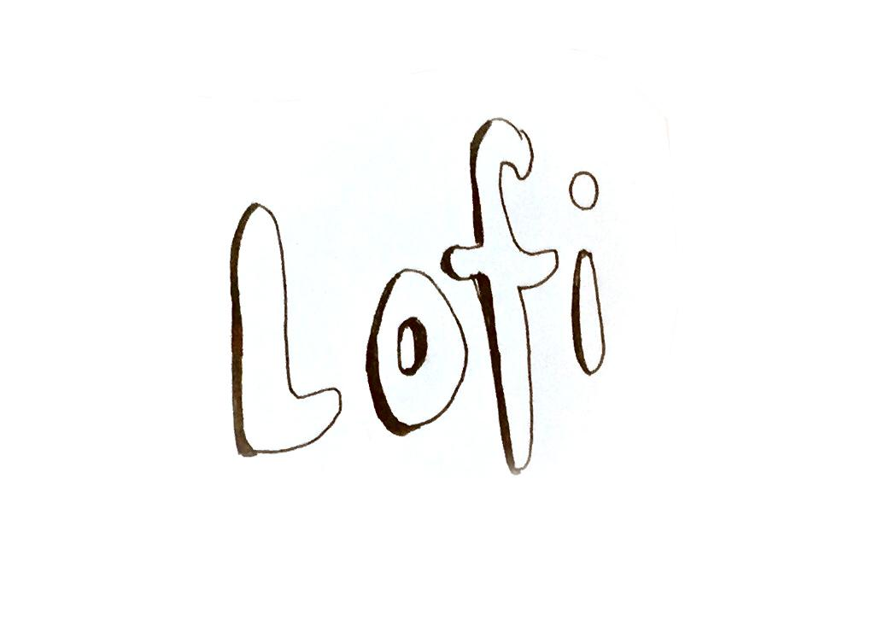
Notes:
This workshop uses the word Lofi as used in the audio world. Lofi recording & music embraces imperfections as part of the recording process

Slide 3
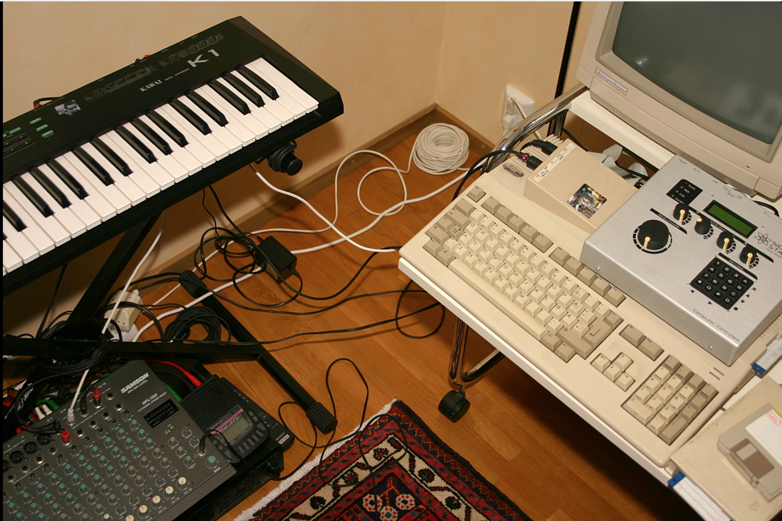
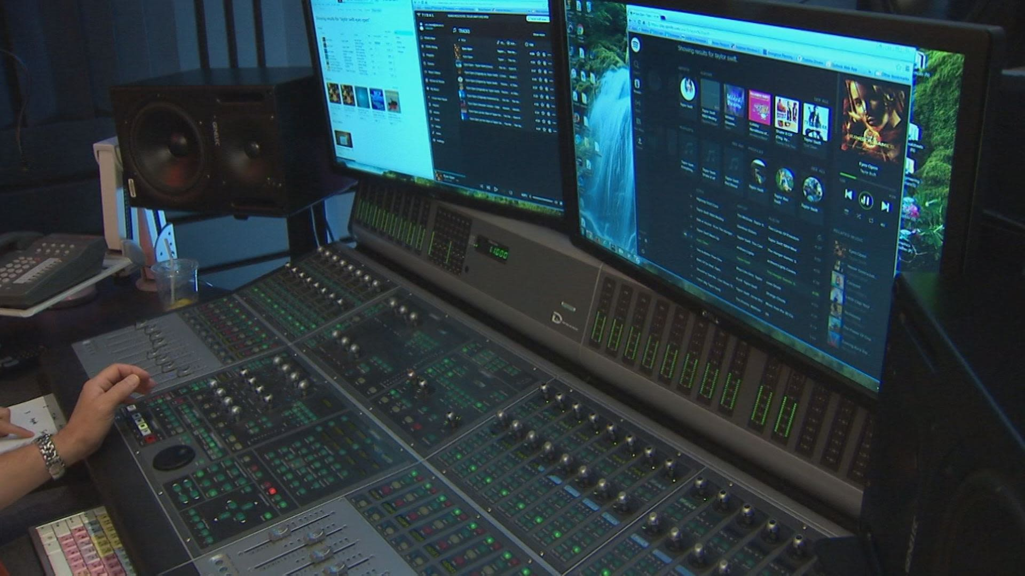
Notes:
Embracing the imperfections of the recording medium
Thinking about terminology, and how lofi vs hif processes afford different abilities in the brainstorm & creation process

Slide 4
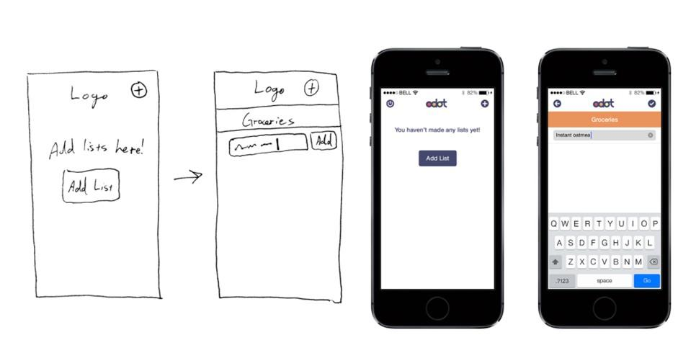
Notes:
Prototyping (Lofi vs Hifi ) in interaction design
How both Low fidelity and High fidelity are helpful tools / methods of making
What do the different styles afford? Each method has its pros & cons

Slide 5
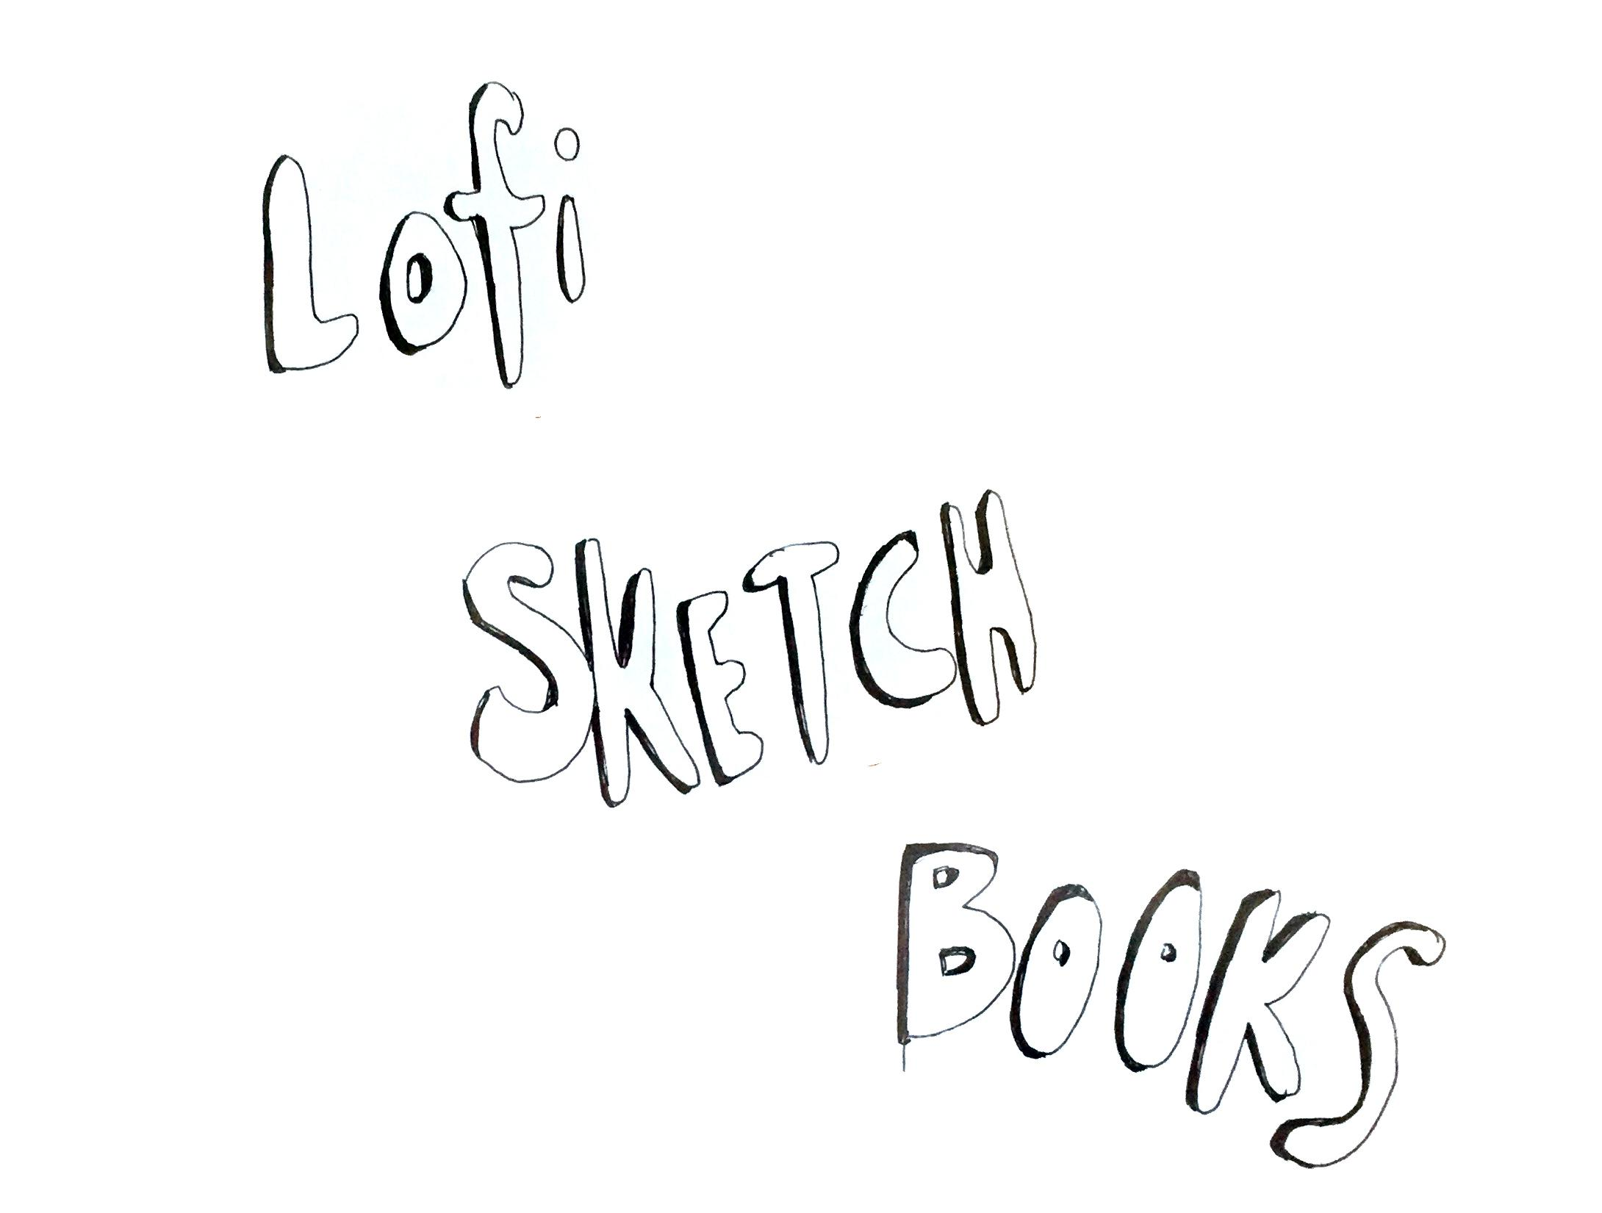
Notes:
why Lofi Sketch Books?

Slide 6
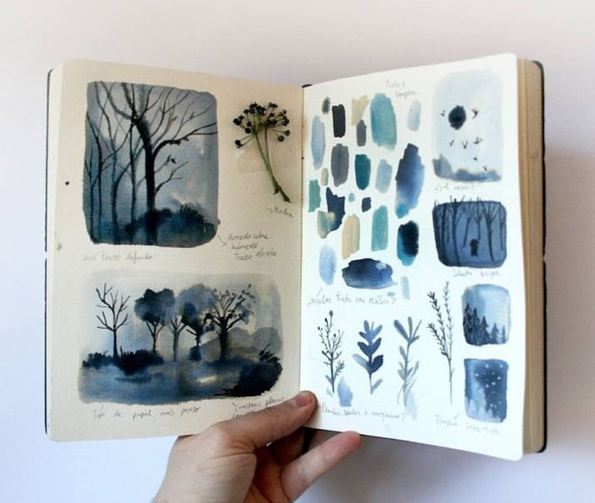
Notes:
Why record our the world around us & our own ideas into a physical space?

Slide 7
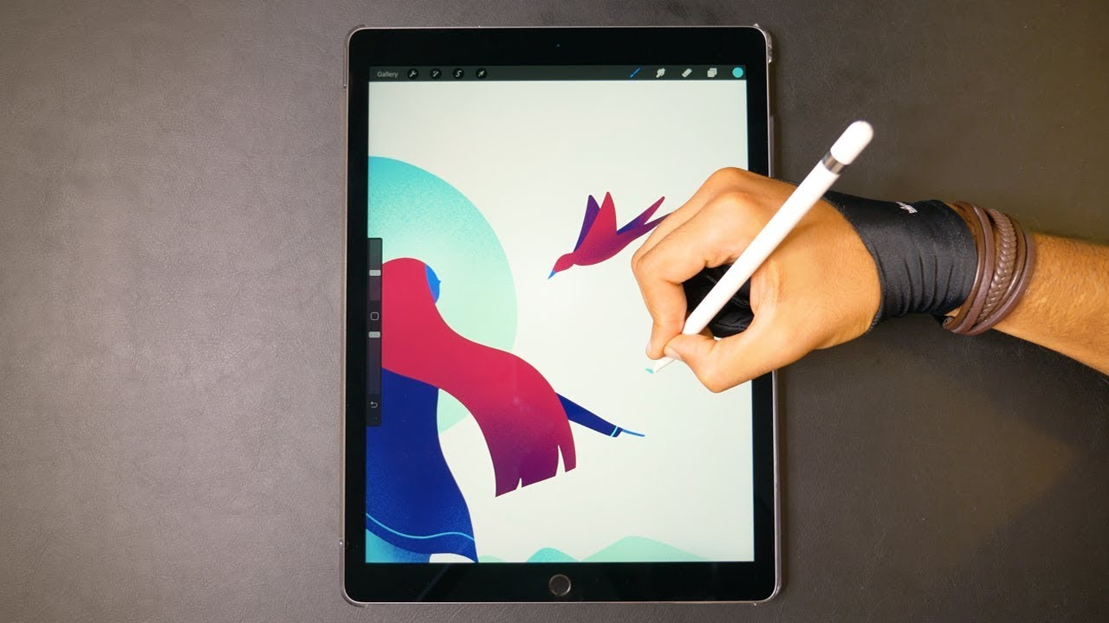
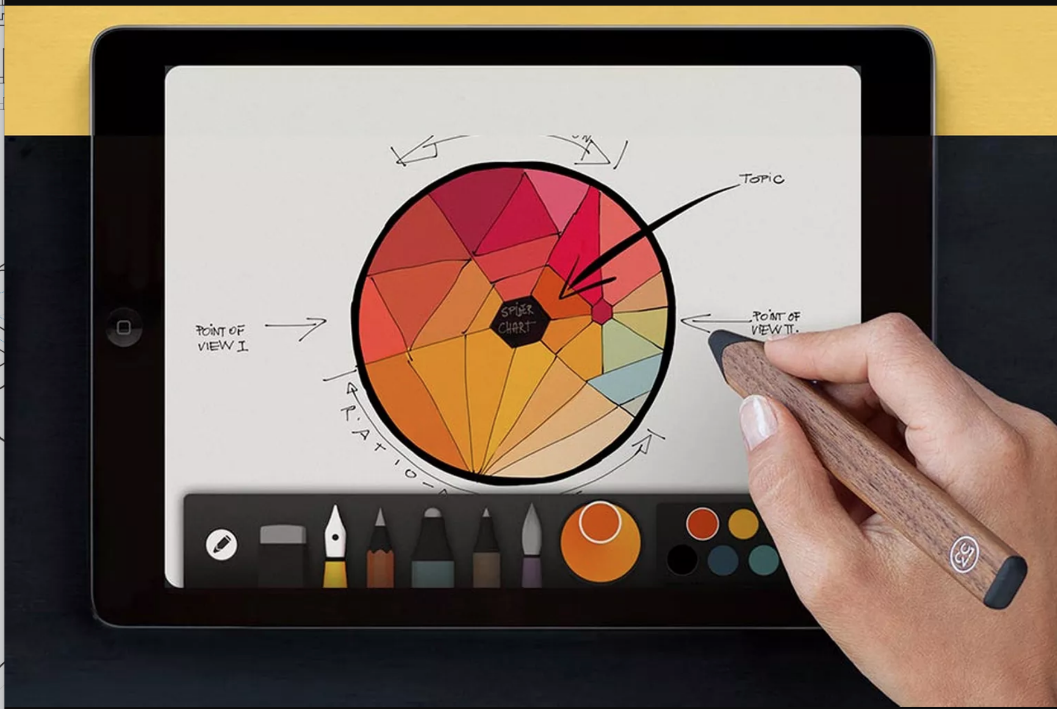
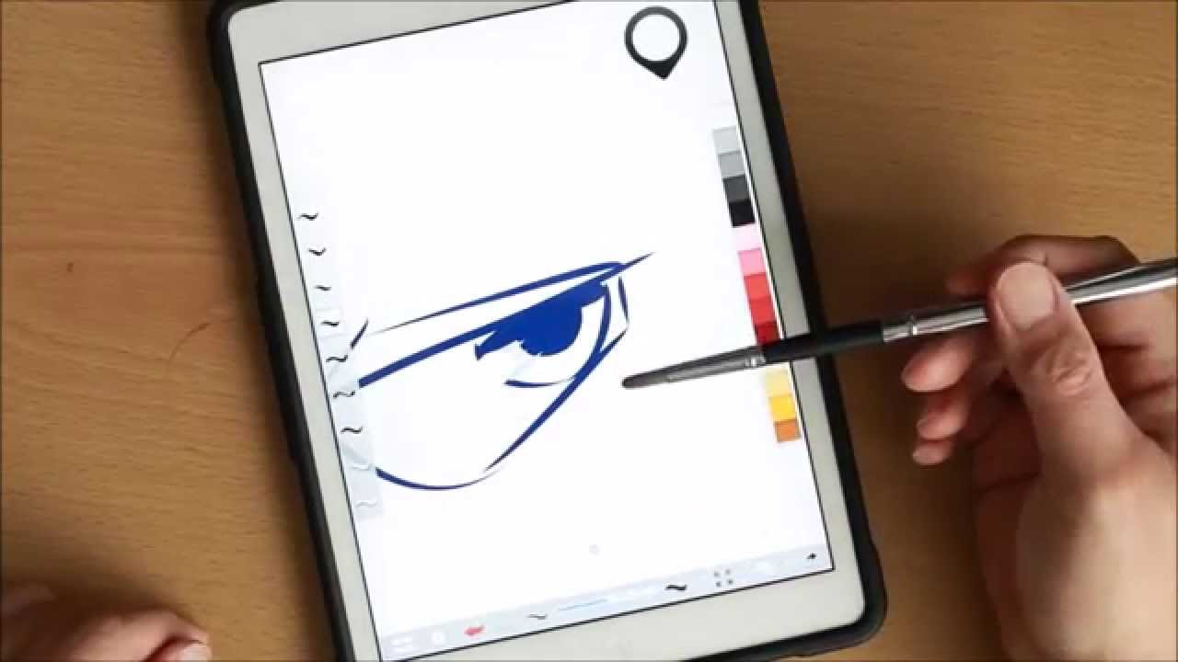
Notes:
When there are digital Sketching & recording tools?
Paper // https://paper.bywetransfer.com/
Adobe Sketch // https://itunes.apple.com/us/app/adobe-photoshop-sketch/id839085644?mt=8
Sensu Brush // https://www.youtube.com/watch?v=ERd_JYq8YNw
[Can ask if there are ones people enjoy? ]

Slide 8
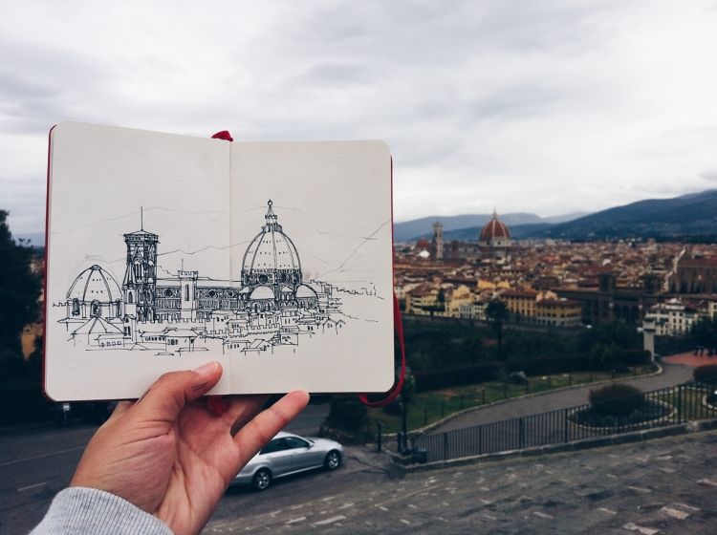
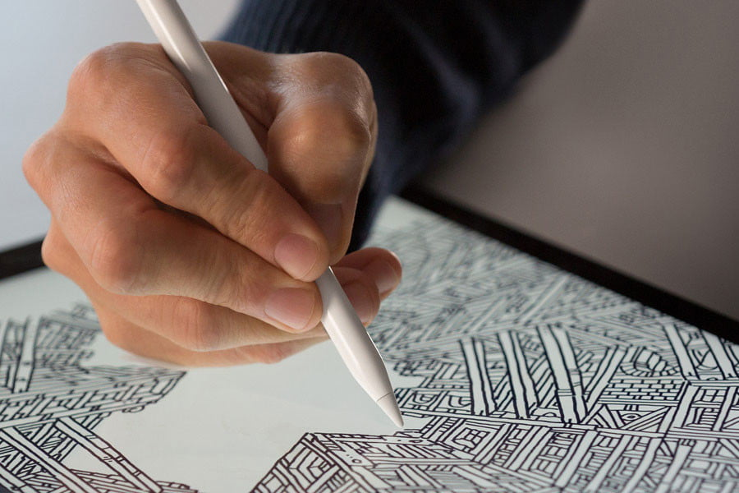
Notes:
Both have their pros & cons / what are the pros of the physical sketchbook in relation to the digital?
[Understanding that often a financial barrier separates the two as well]
[can always scan from the physical into the digital later too]

Slide 9
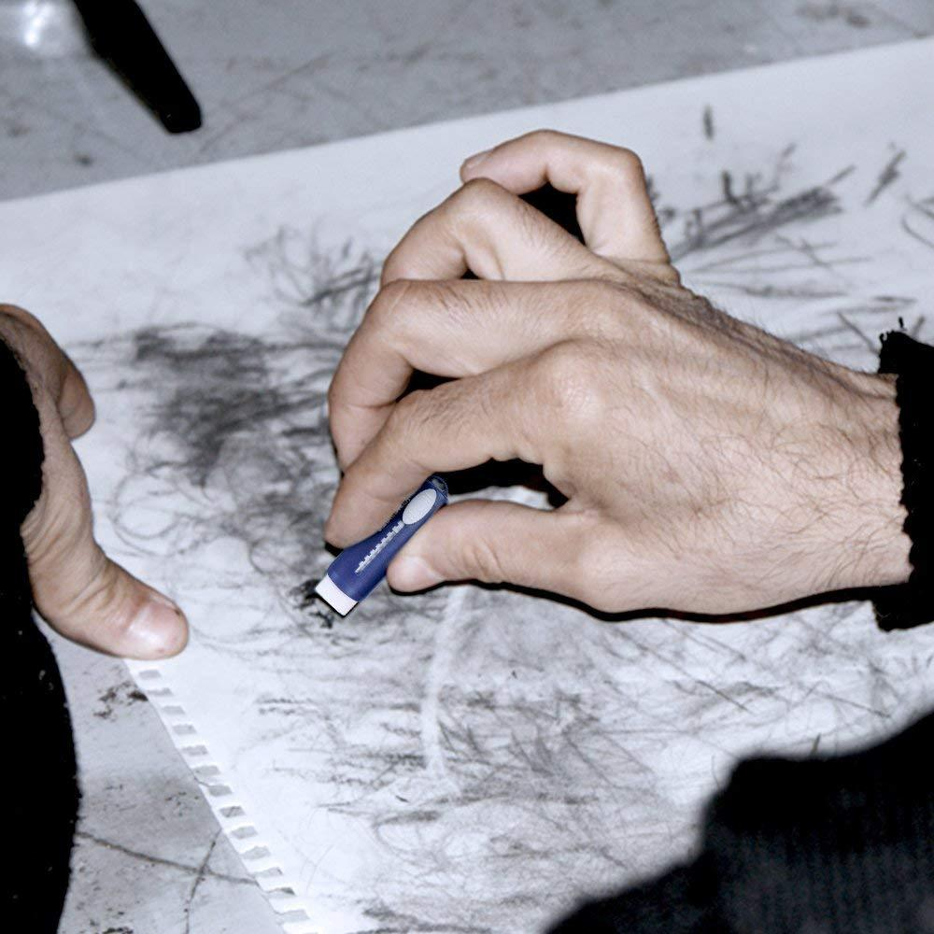

Notes:
What are the benefits to no undo button?
Paper has a limited memory / no undo button - becoming a creative constraint, an aspect that we embrace as part of the process.
Sometimes we have a tendency to delete lines or ideas when recording in digital apps, that could actually be helpful to us when developing an artistic style. Or maybe an idea that didn't seem so great in that moment will become foundational for ideas in the future.

Slide 10
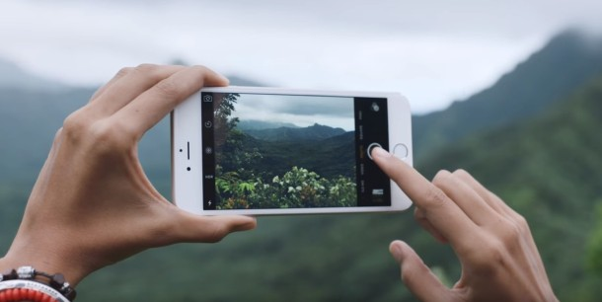

Notes:
Although our phone cameras are amazingly fantastic tools, sometimes we can forget to sift back through the shots we took to really critically understand what it was about that moment that resonated so deeply with us.
When we record by drawing or writing into a sketchbook or journal, we’re often processing the information in a different way, selecting elements to highlight in that moment to represent what it was that really struck us.

Slide 11
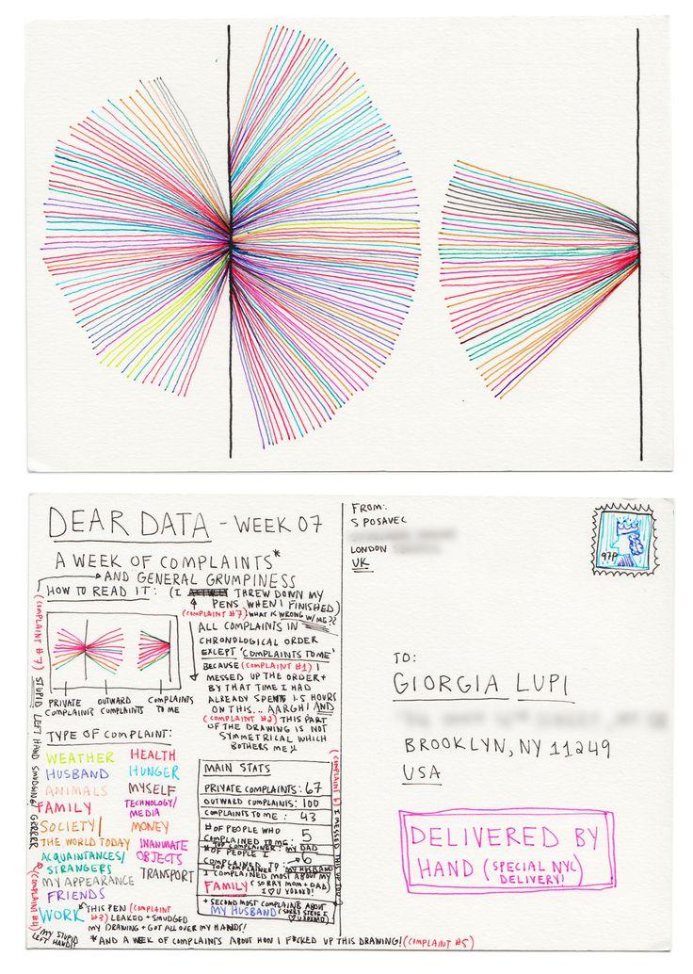
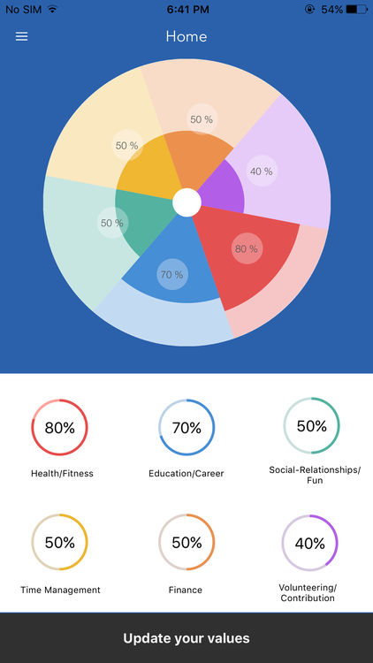
Notes:
Dear Data Project
Dear Data: The Book & Project site // by Giorgia Lupi and Stefanie Posavec
Tracking physically vs digitally, what does drawing our own data tell us about ourselves and the world verses tracking it digitally?

Slide 12
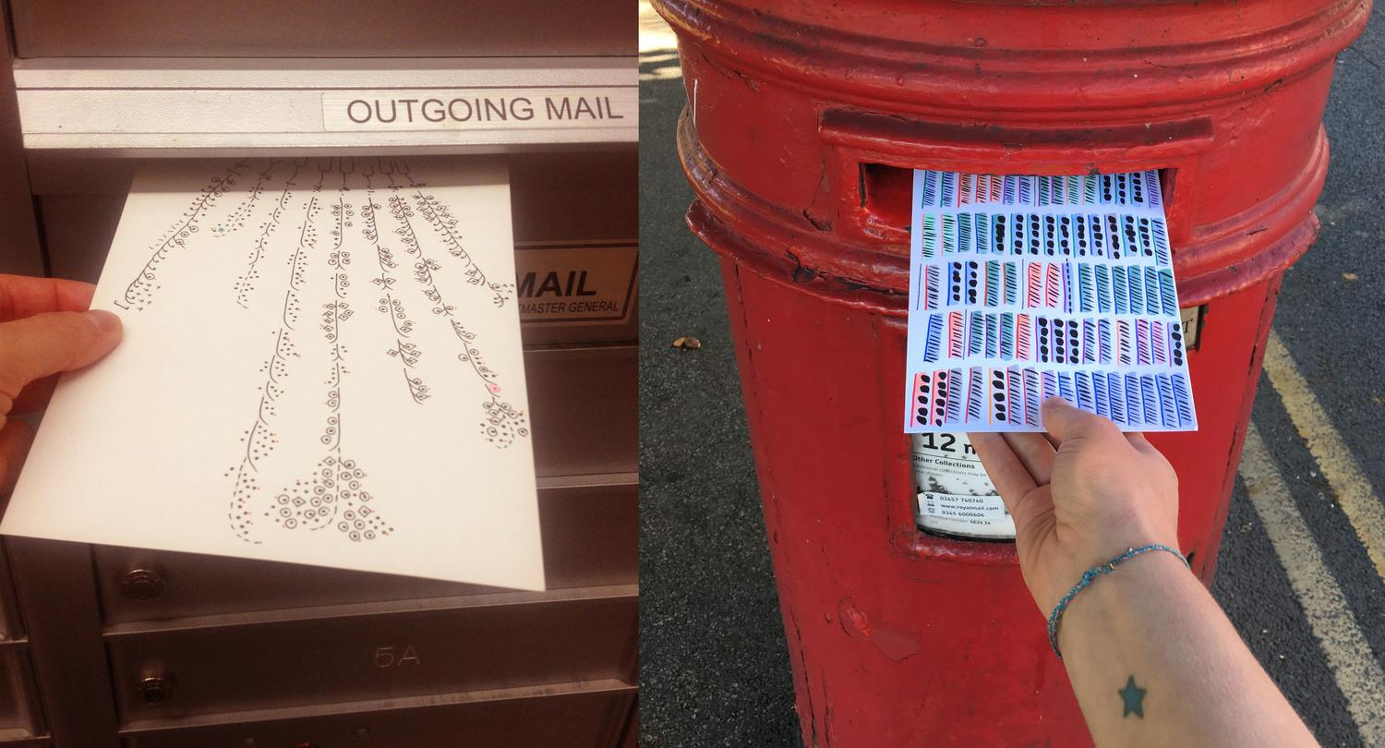
Notes:
Each week, and for a year, we collected and measured a particular type of data about our lives, used this data to make a drawing on a postcard-sized sheet of paper, and then dropped the postcard in an English “postbox” (Stefanie) or an American “mailbox” (Giorgia)
Eventually, the postcard arrived at the other person’s address with all the scuff marks of its journey over the ocean: a type of “slow data” transmission.

Slide 13
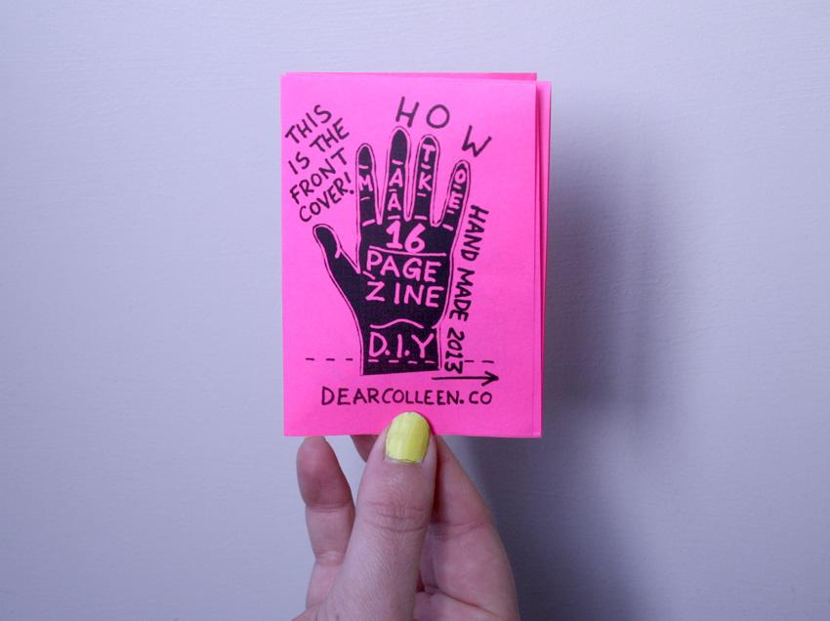

Notes:
Today we’ll explore & make 2 simple book forms as sketchbooks:
1 pg zine booklet
Accordion fold

Slide 14
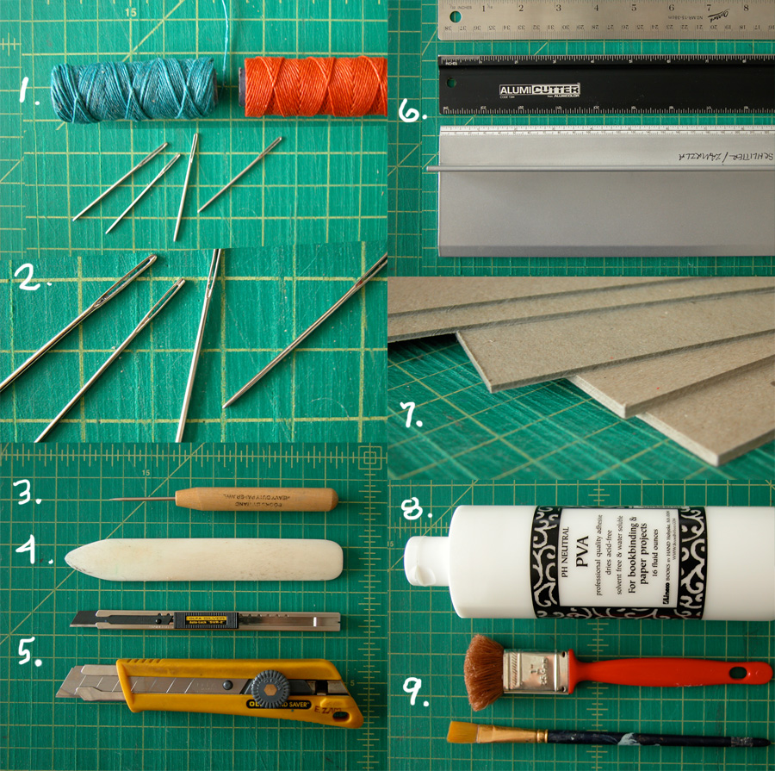
Notes:
Image of some Traditional bookbinding materials:
Ex:
Waxed linen thread (for stitched binding like pamphlet style)
PVA archival glue
Bookbinding needles
Book Board for covers
Bone Folder

Slide 15
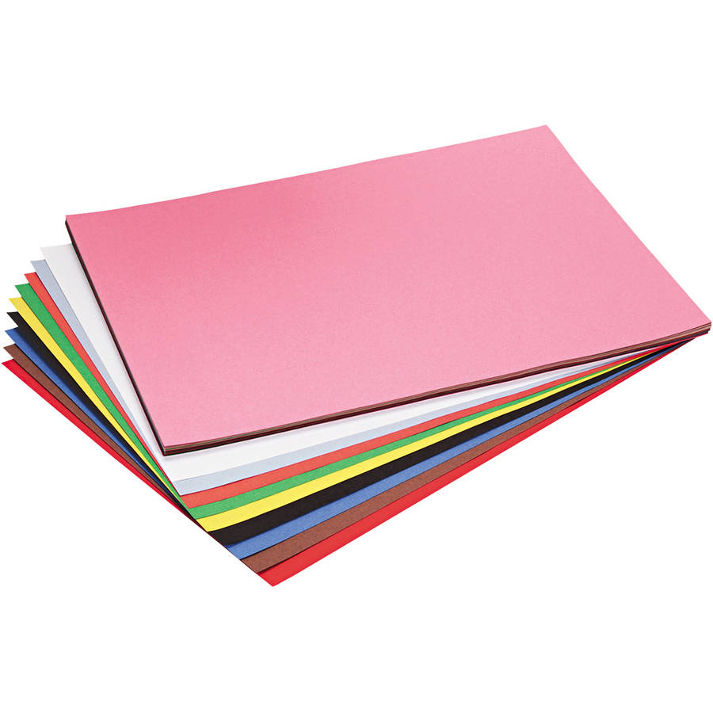
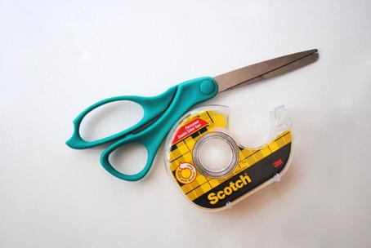

Notes:
For Lofi, we’ll use items that you could find anywhere that sells office supplies or maybe lying around at school or the house?
Scissors, double sided tape (or gluestick), and paper

Slide 16
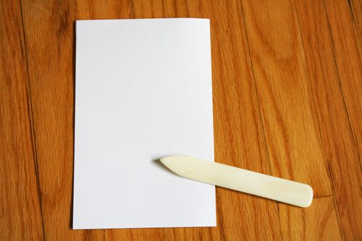
Notes:
If you’re folding a lot at once? Can be useful to purchase a bone folder to save your fingers or wrist? (many are real bone but there are synthetics too <3)
But can also use the back of your scissors or a dull butterknife

Slide 17
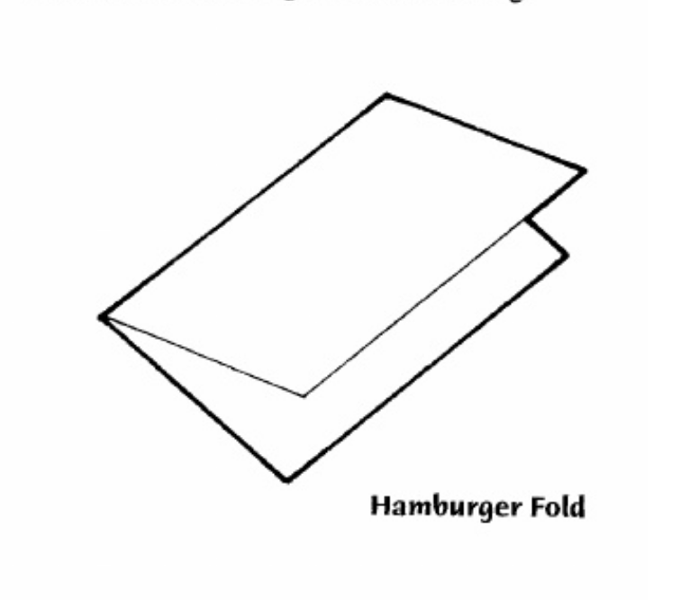
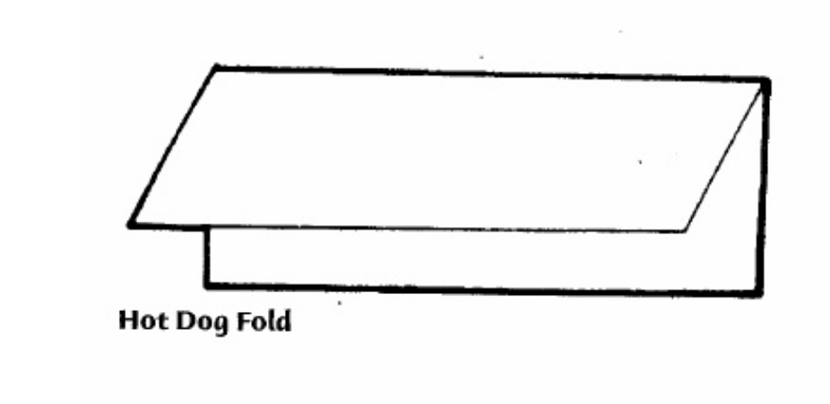
Notes:
We’ll use visual comparisons to help remember folds as we go through our 2 book formats:
Hamburger = fold across its width
Hot Dog fold = fold across its length

Slide 18
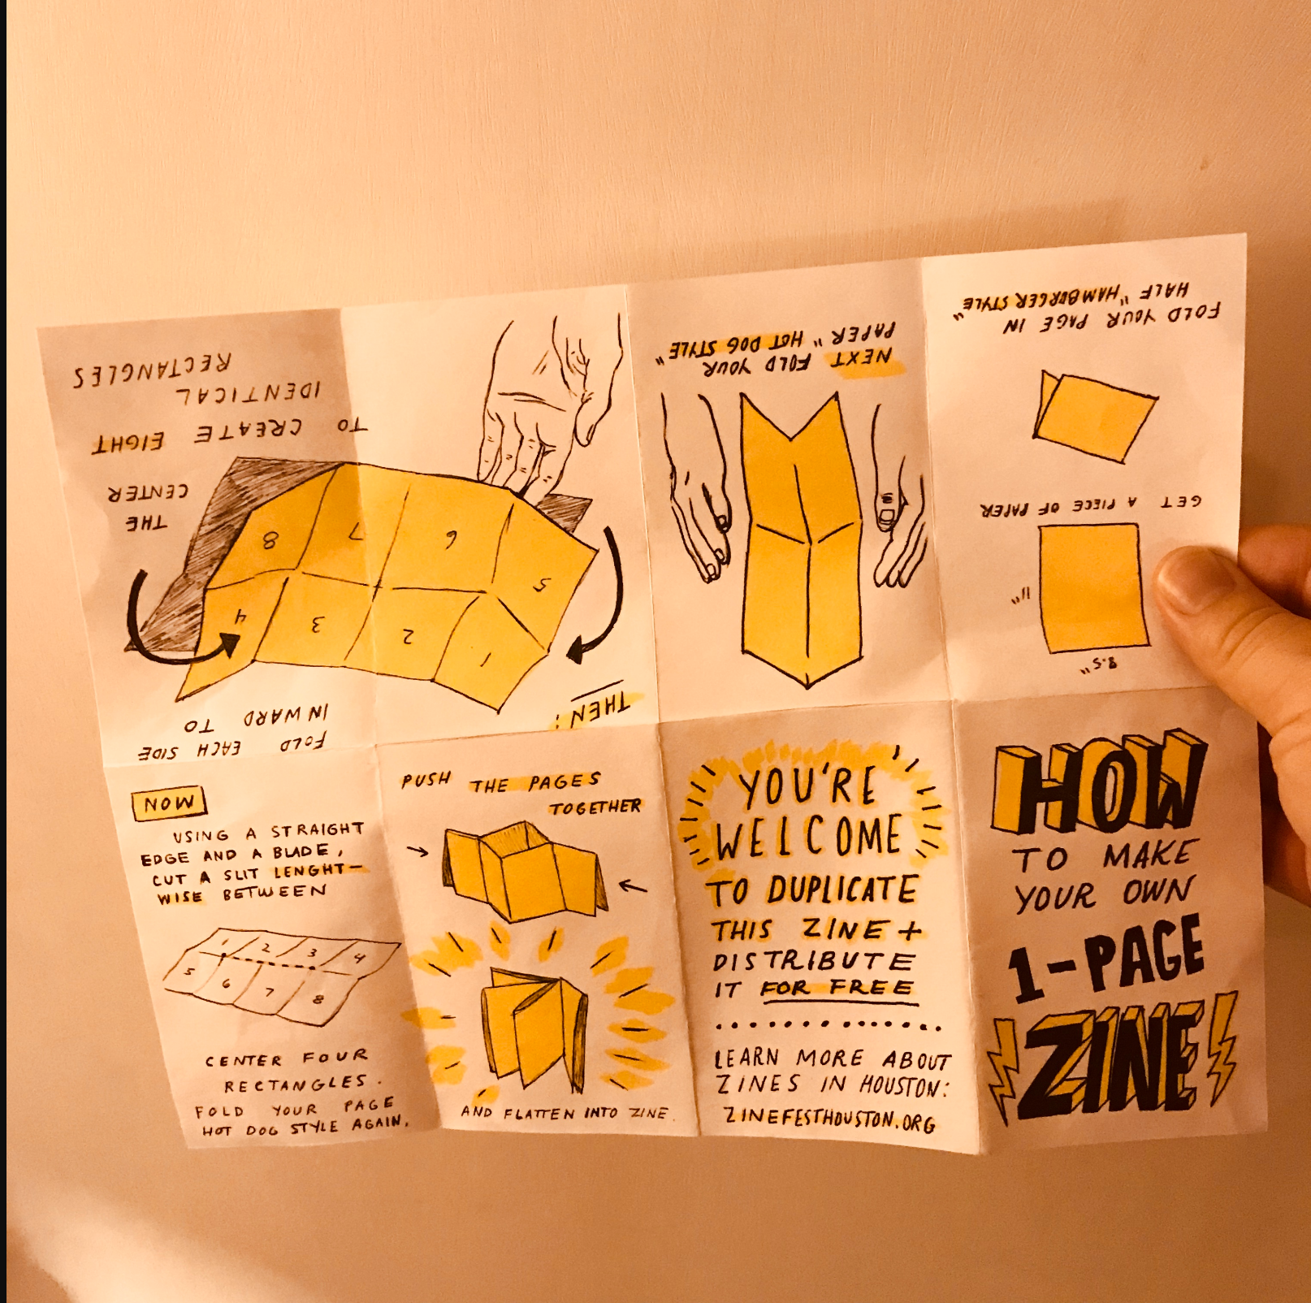
Notes:
Ho to make your own 1 page zine booklet

Slide 19
Notes:
National Monument Press is a publishing project by Oakland based artist Zach Clark
Risograph

Slide 21
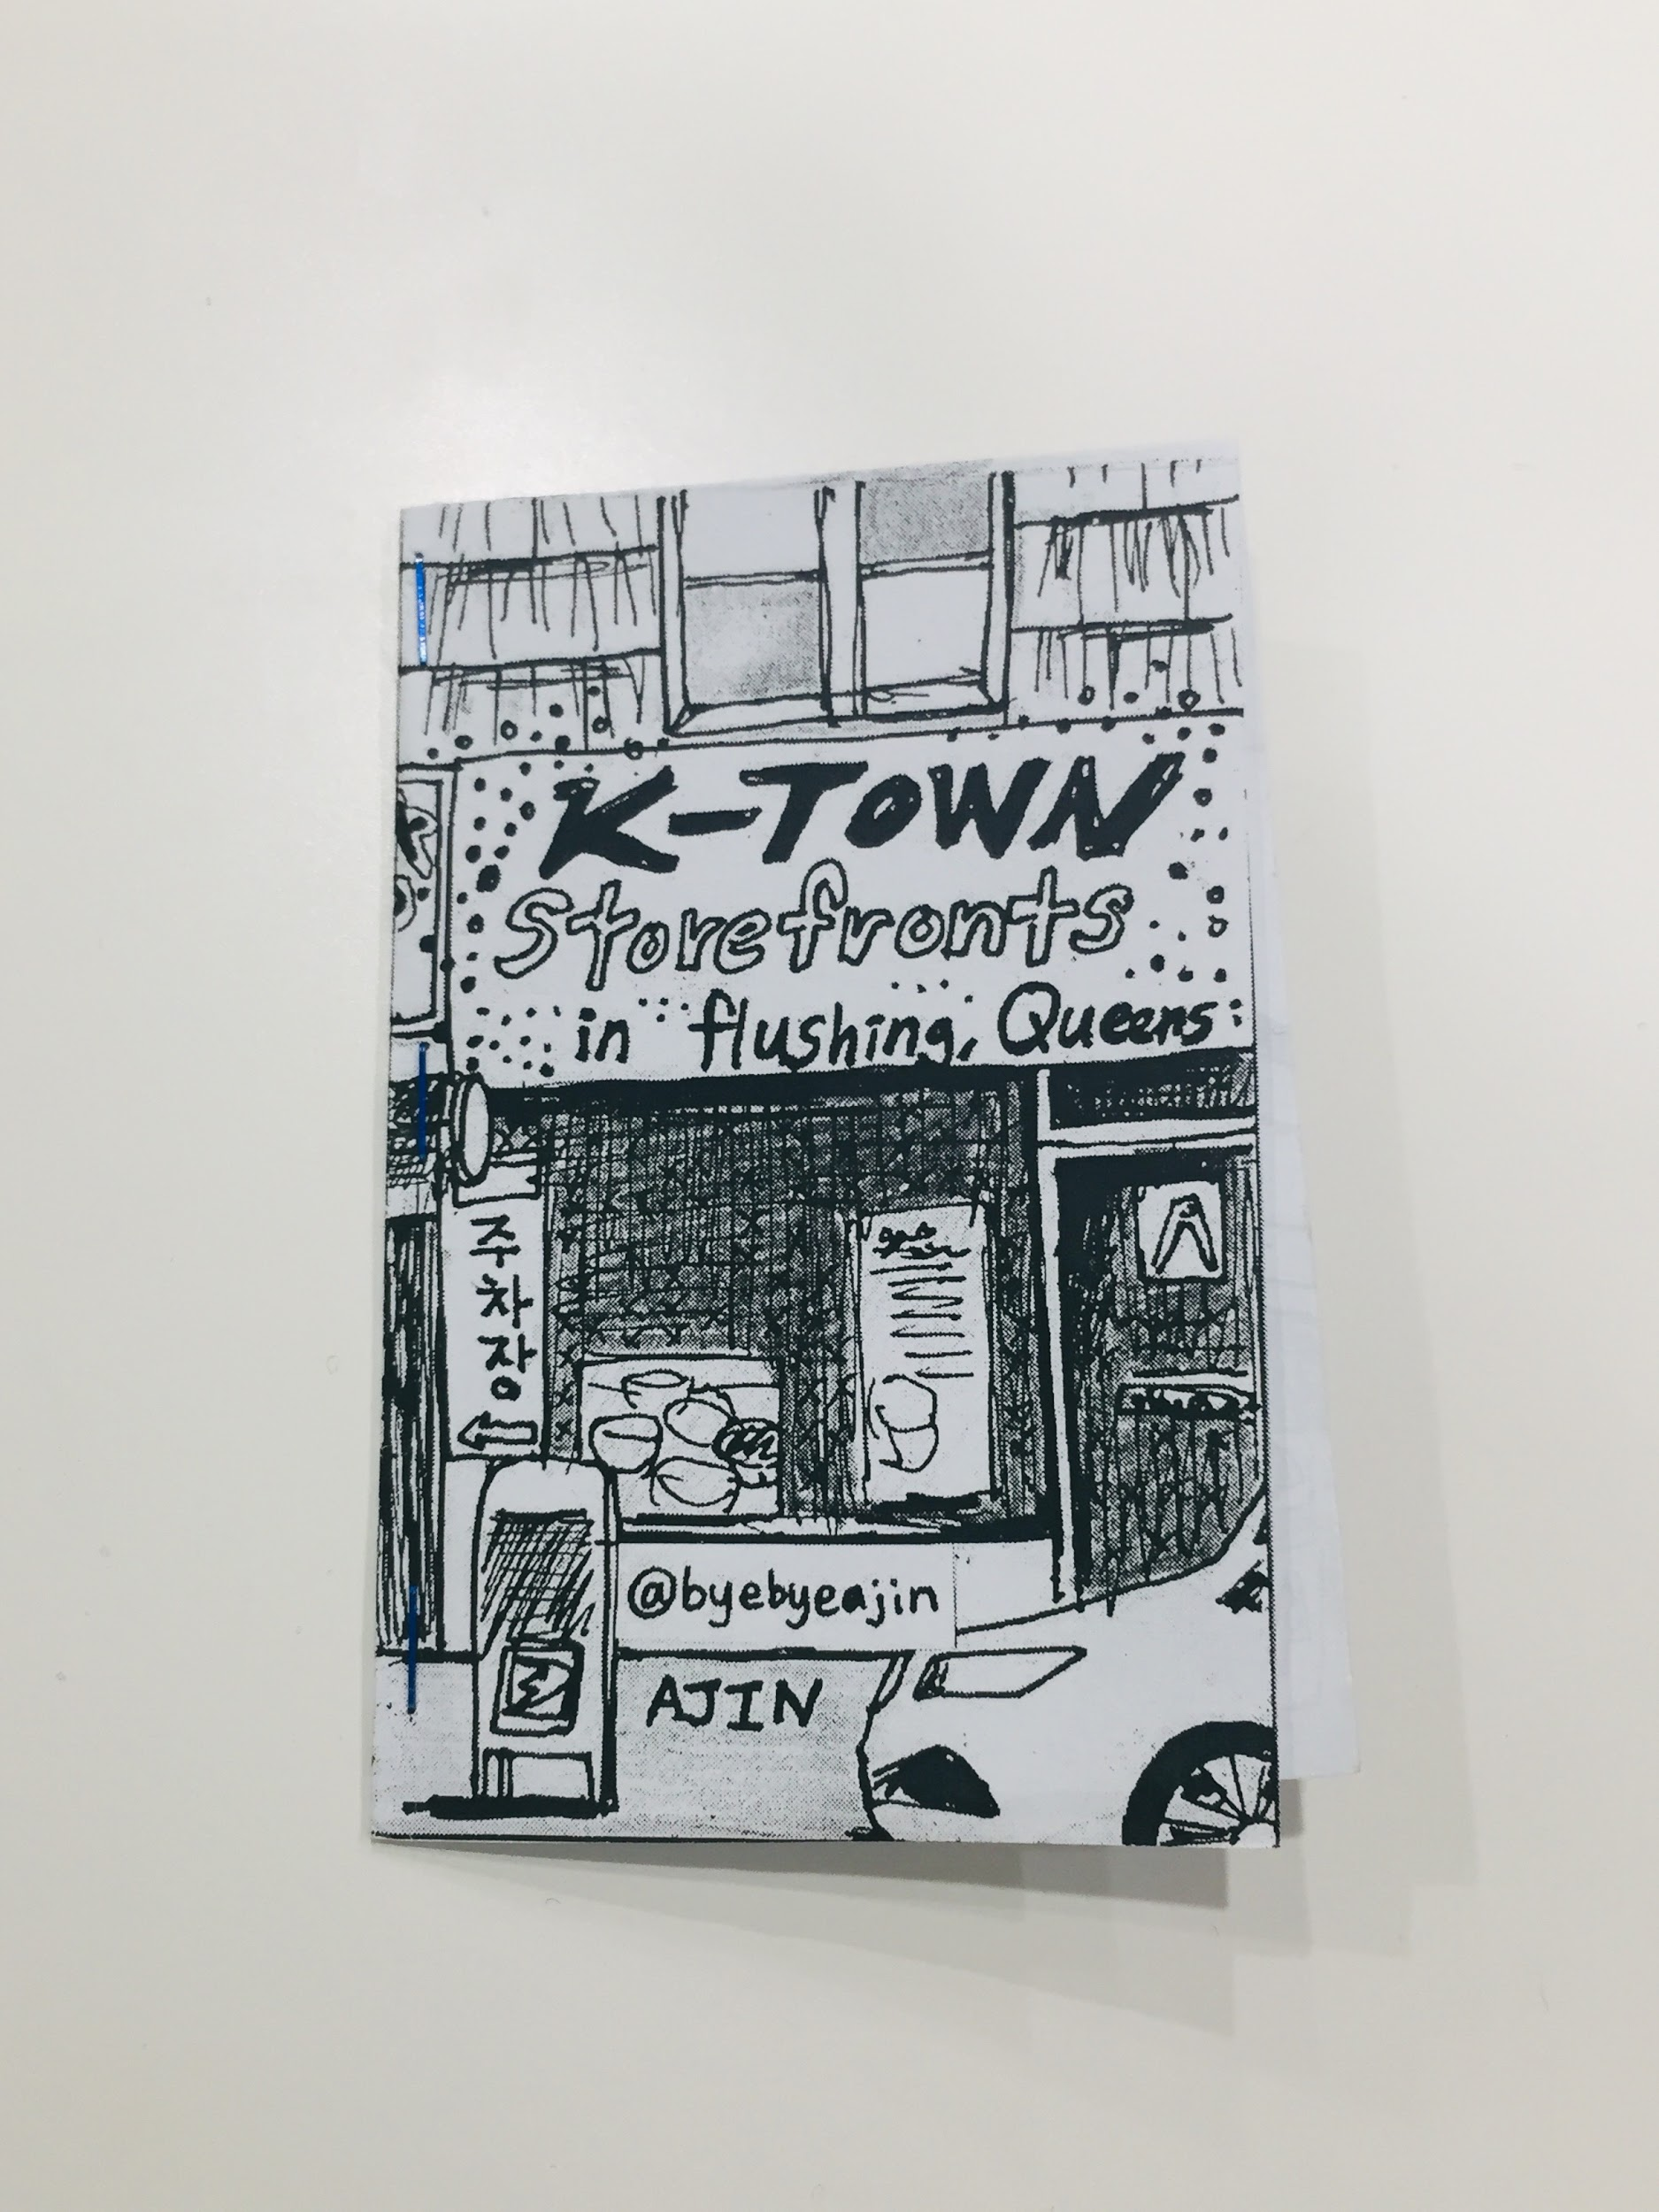
Notes:
Exploring a physical environment
@byebyeajin / brooklyn based but now in Yongsan South Korea

Slide 22
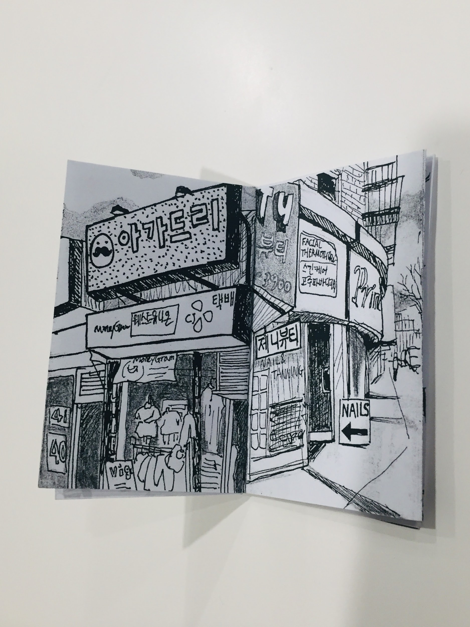
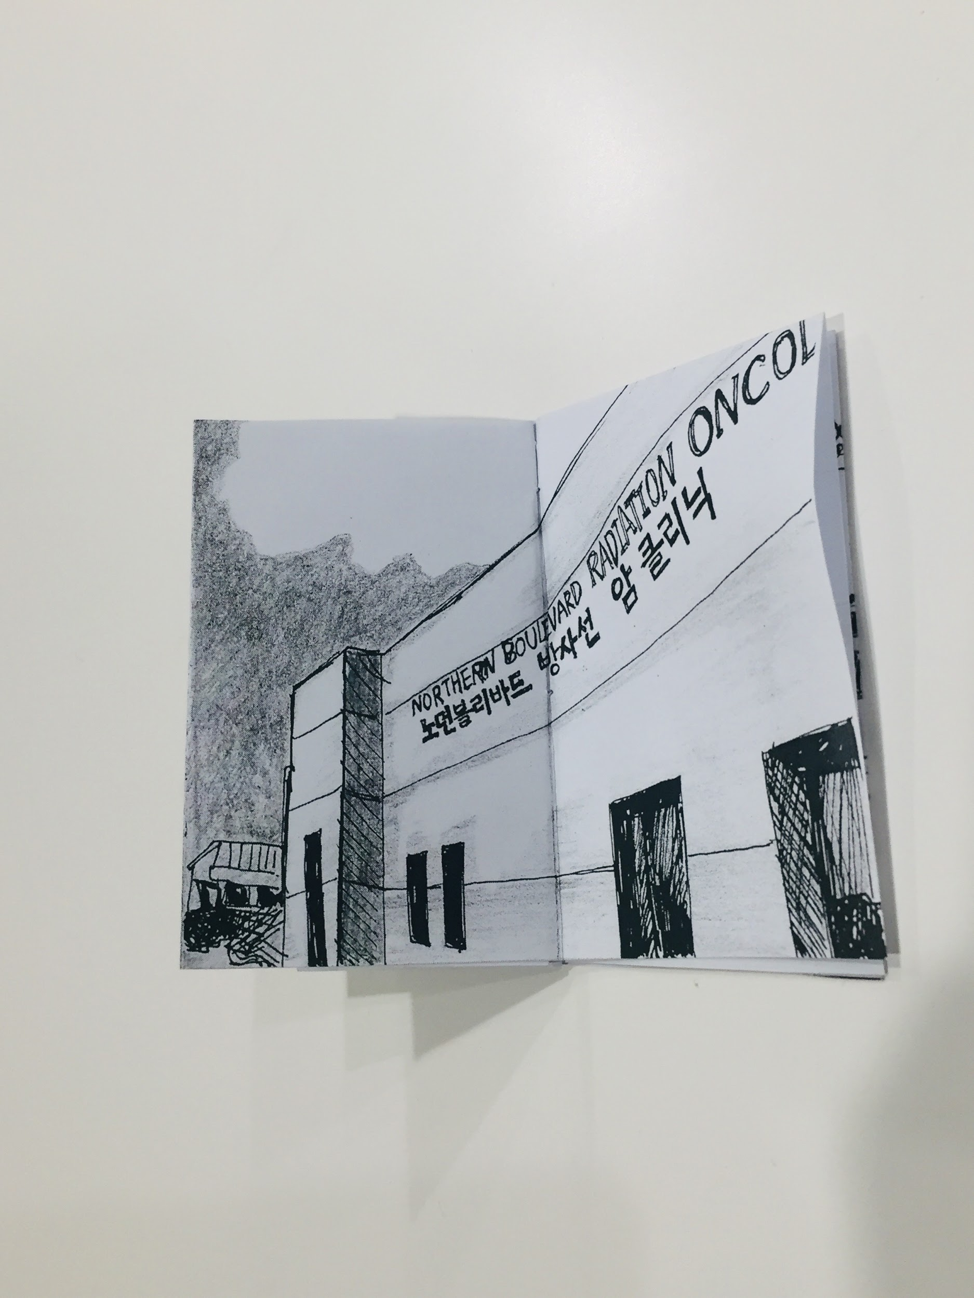
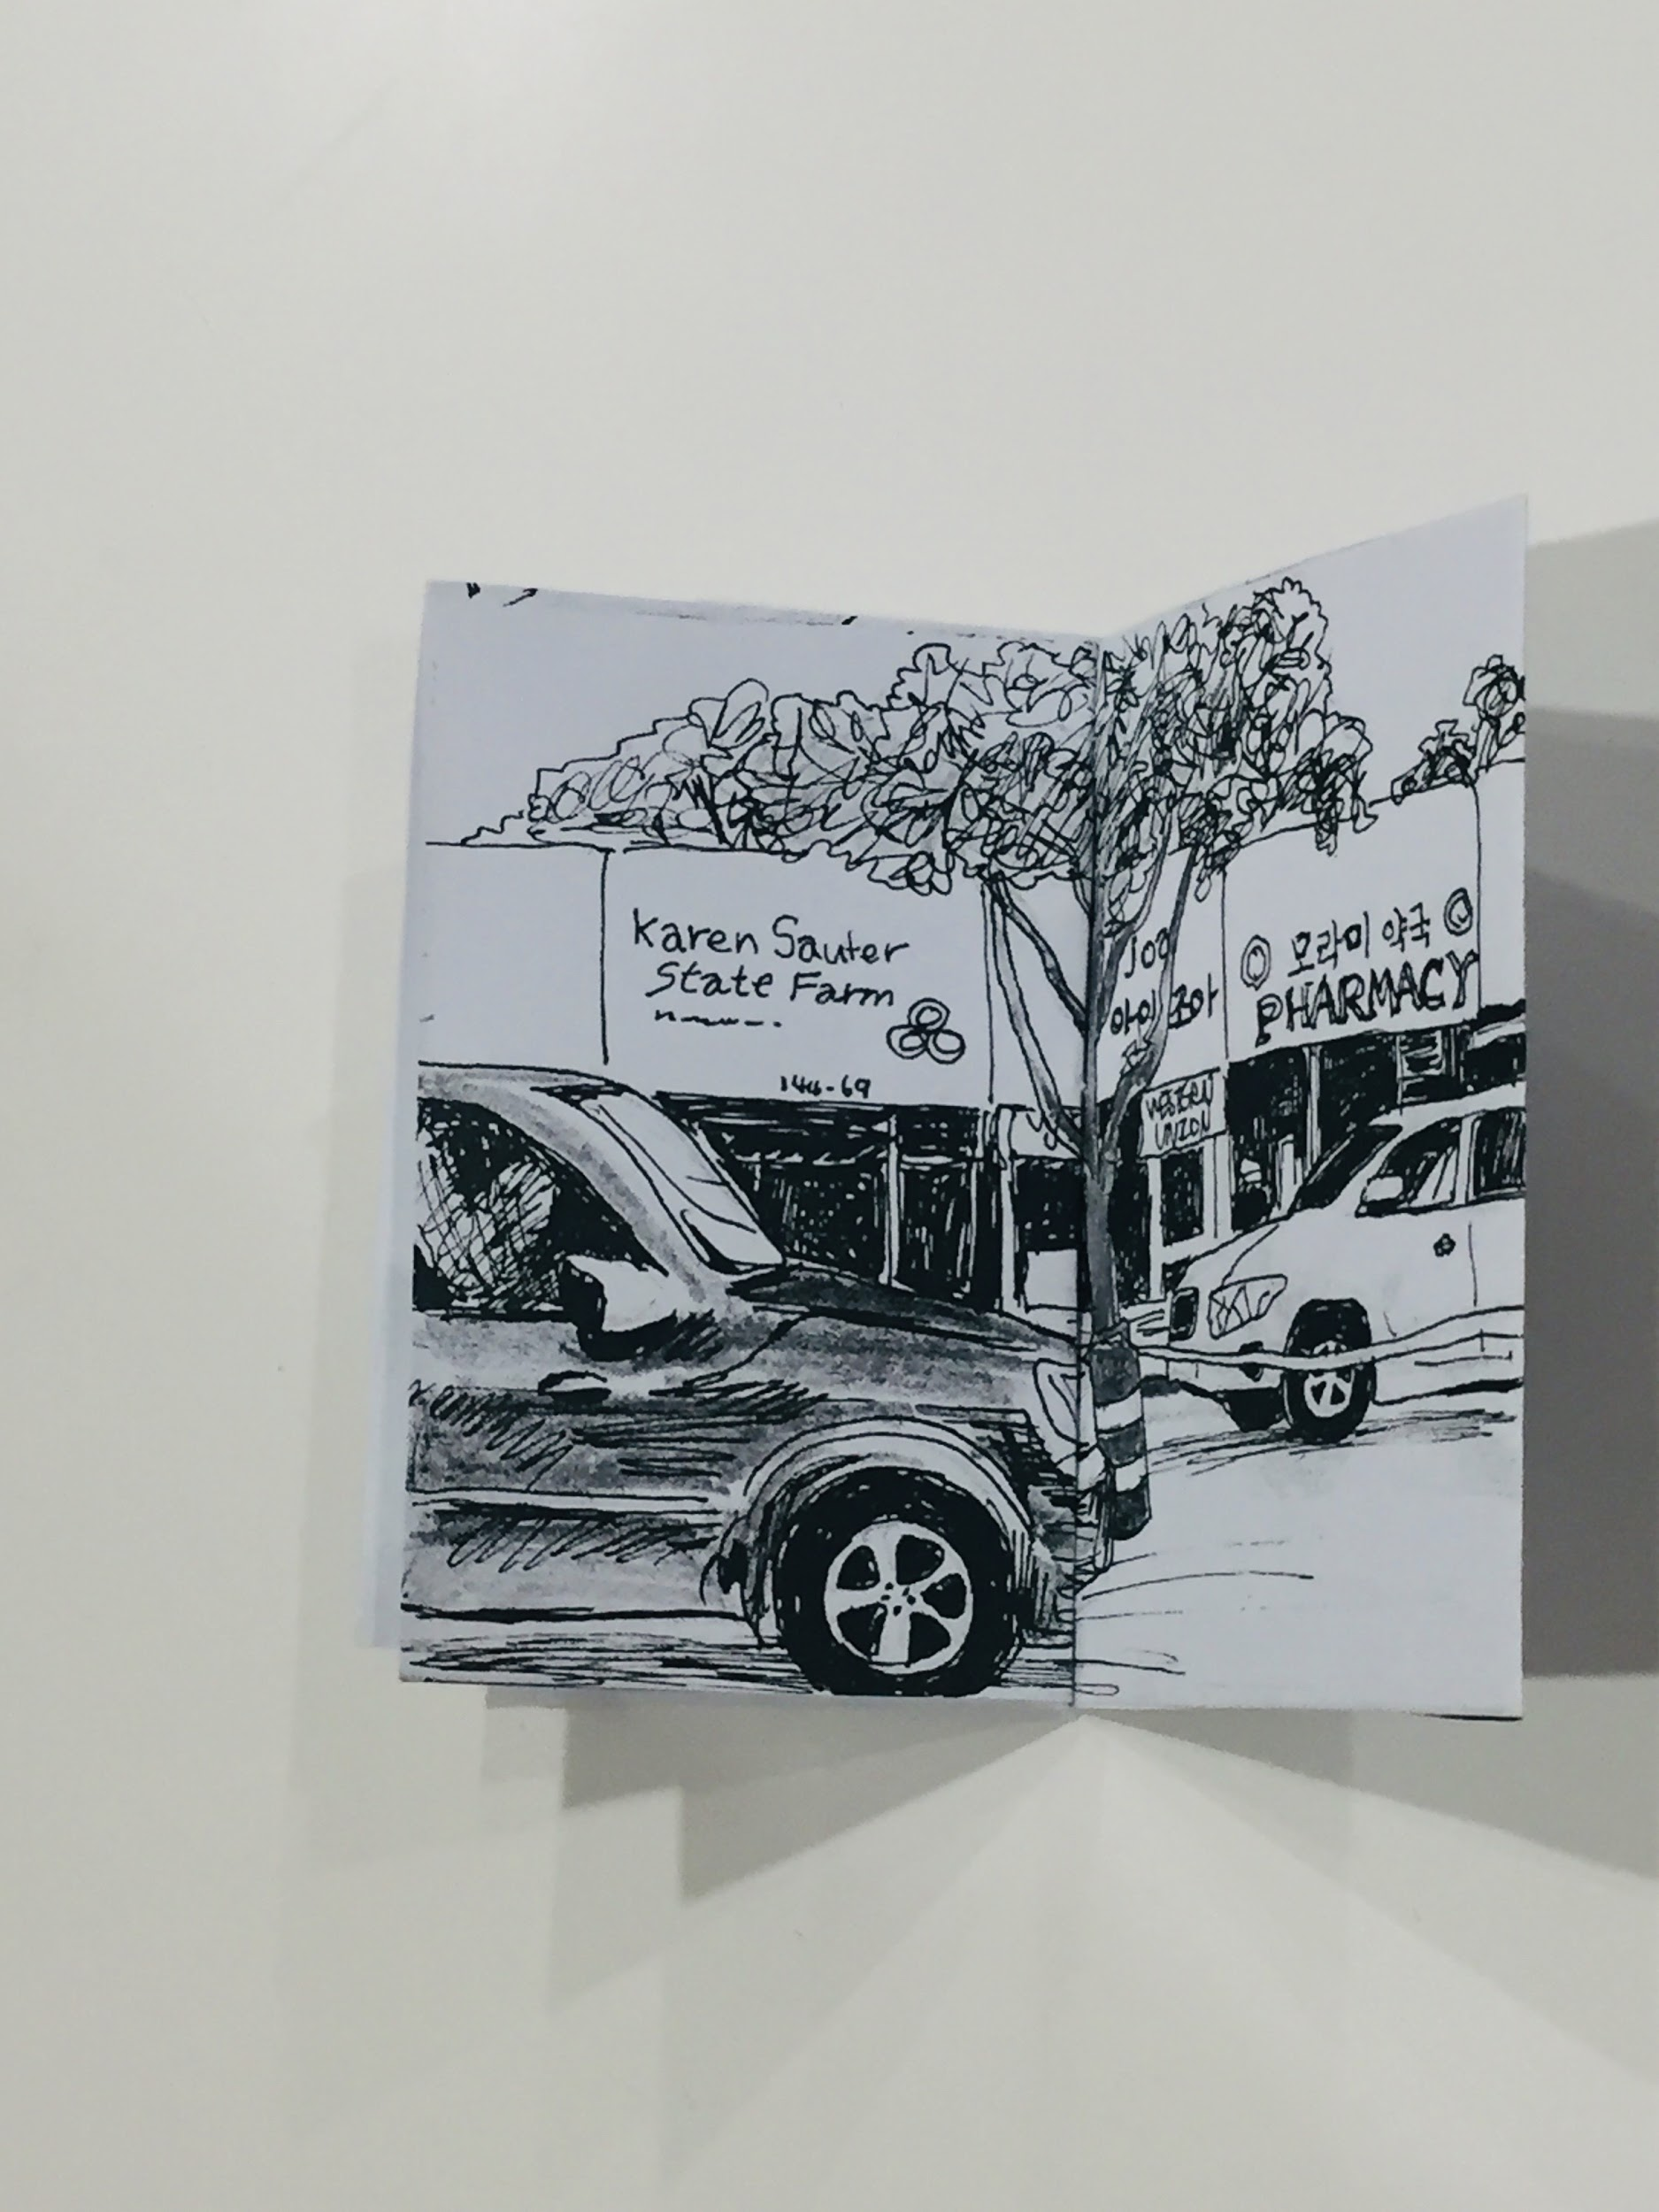

Slide 23
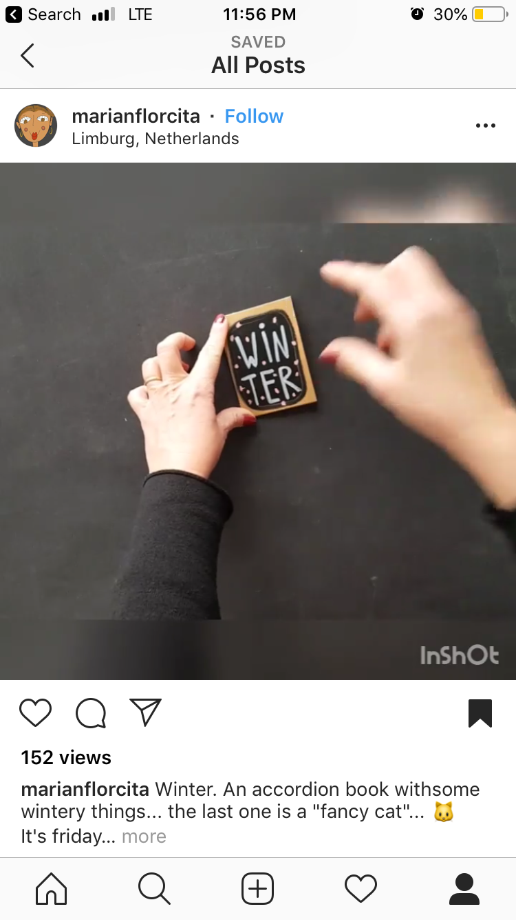
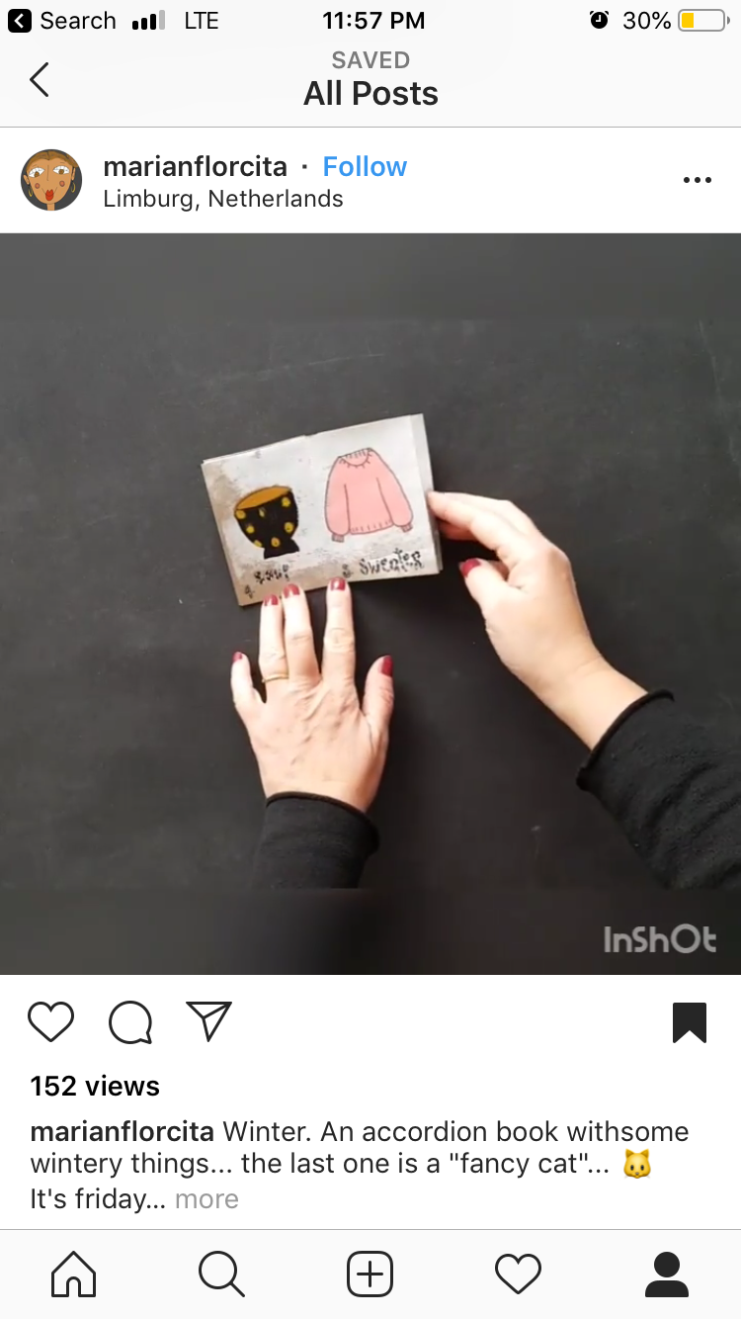
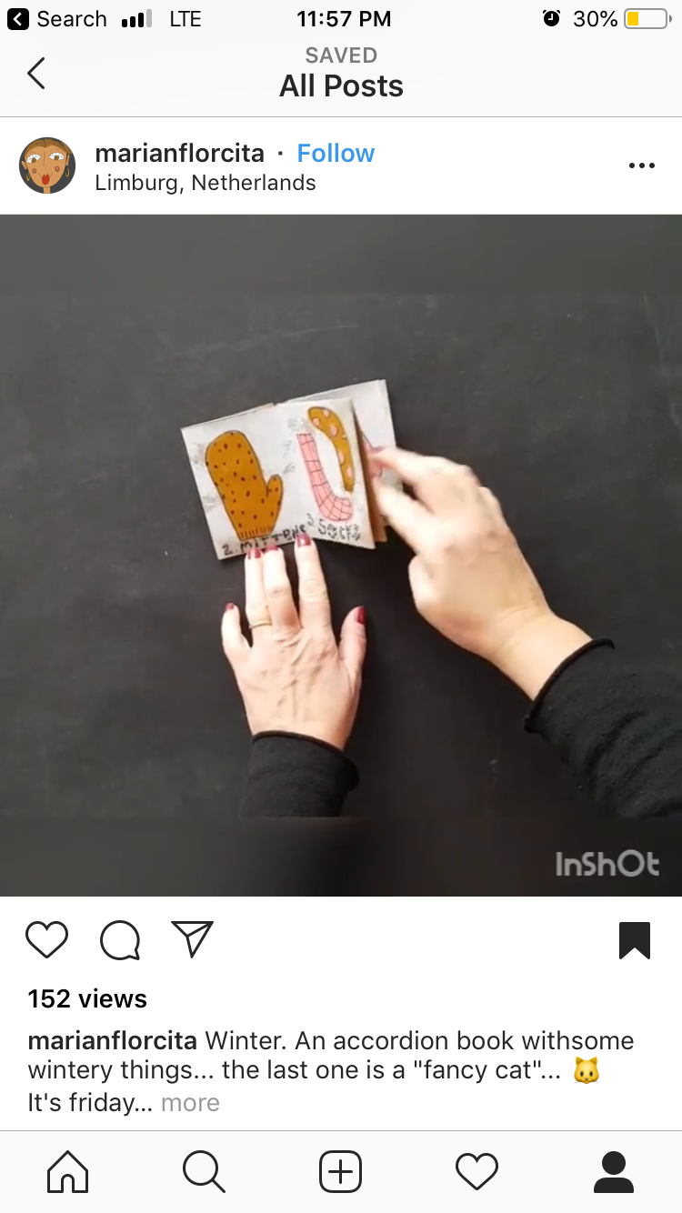
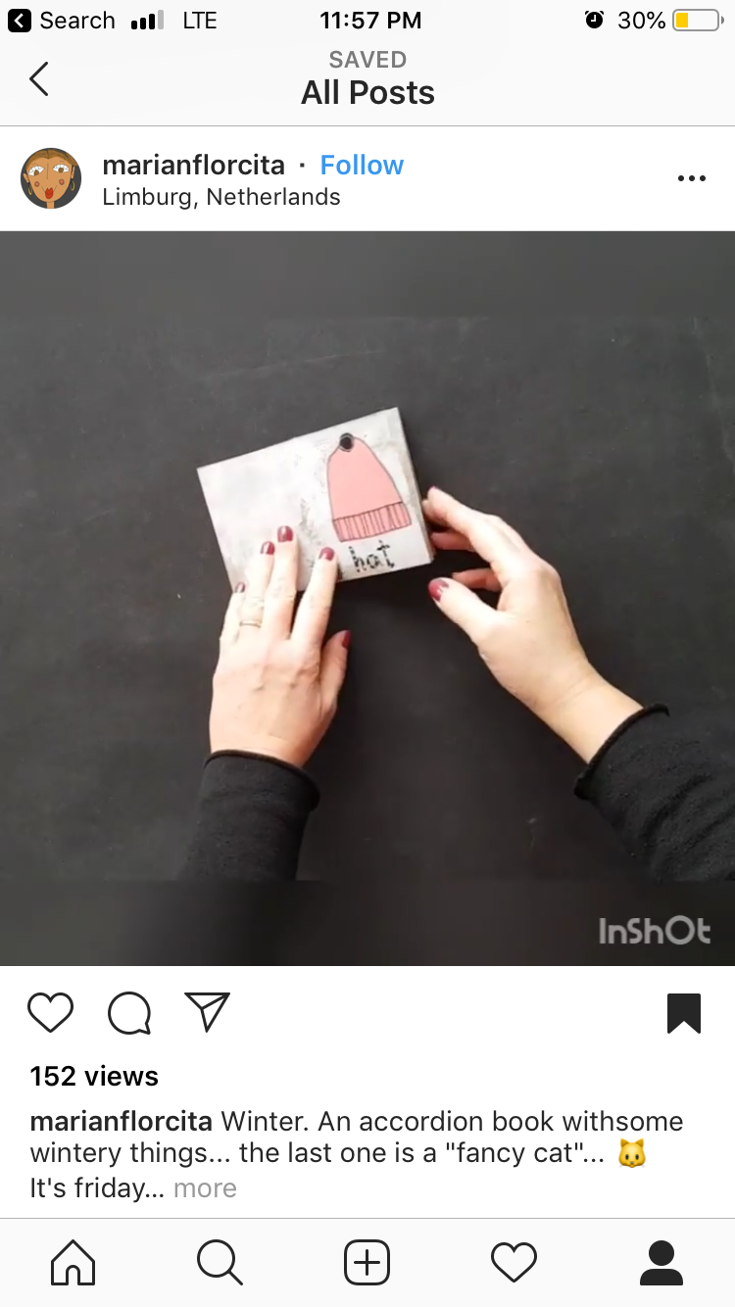
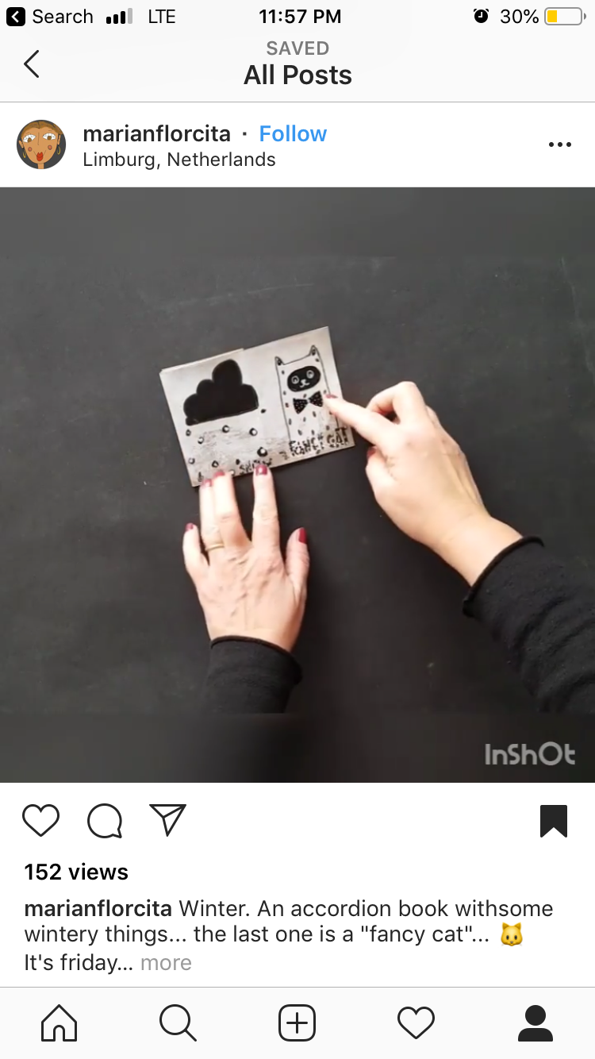
Notes:
Winter Zine by Marian florcita
Exploring associations of 1 topic

Slide 24
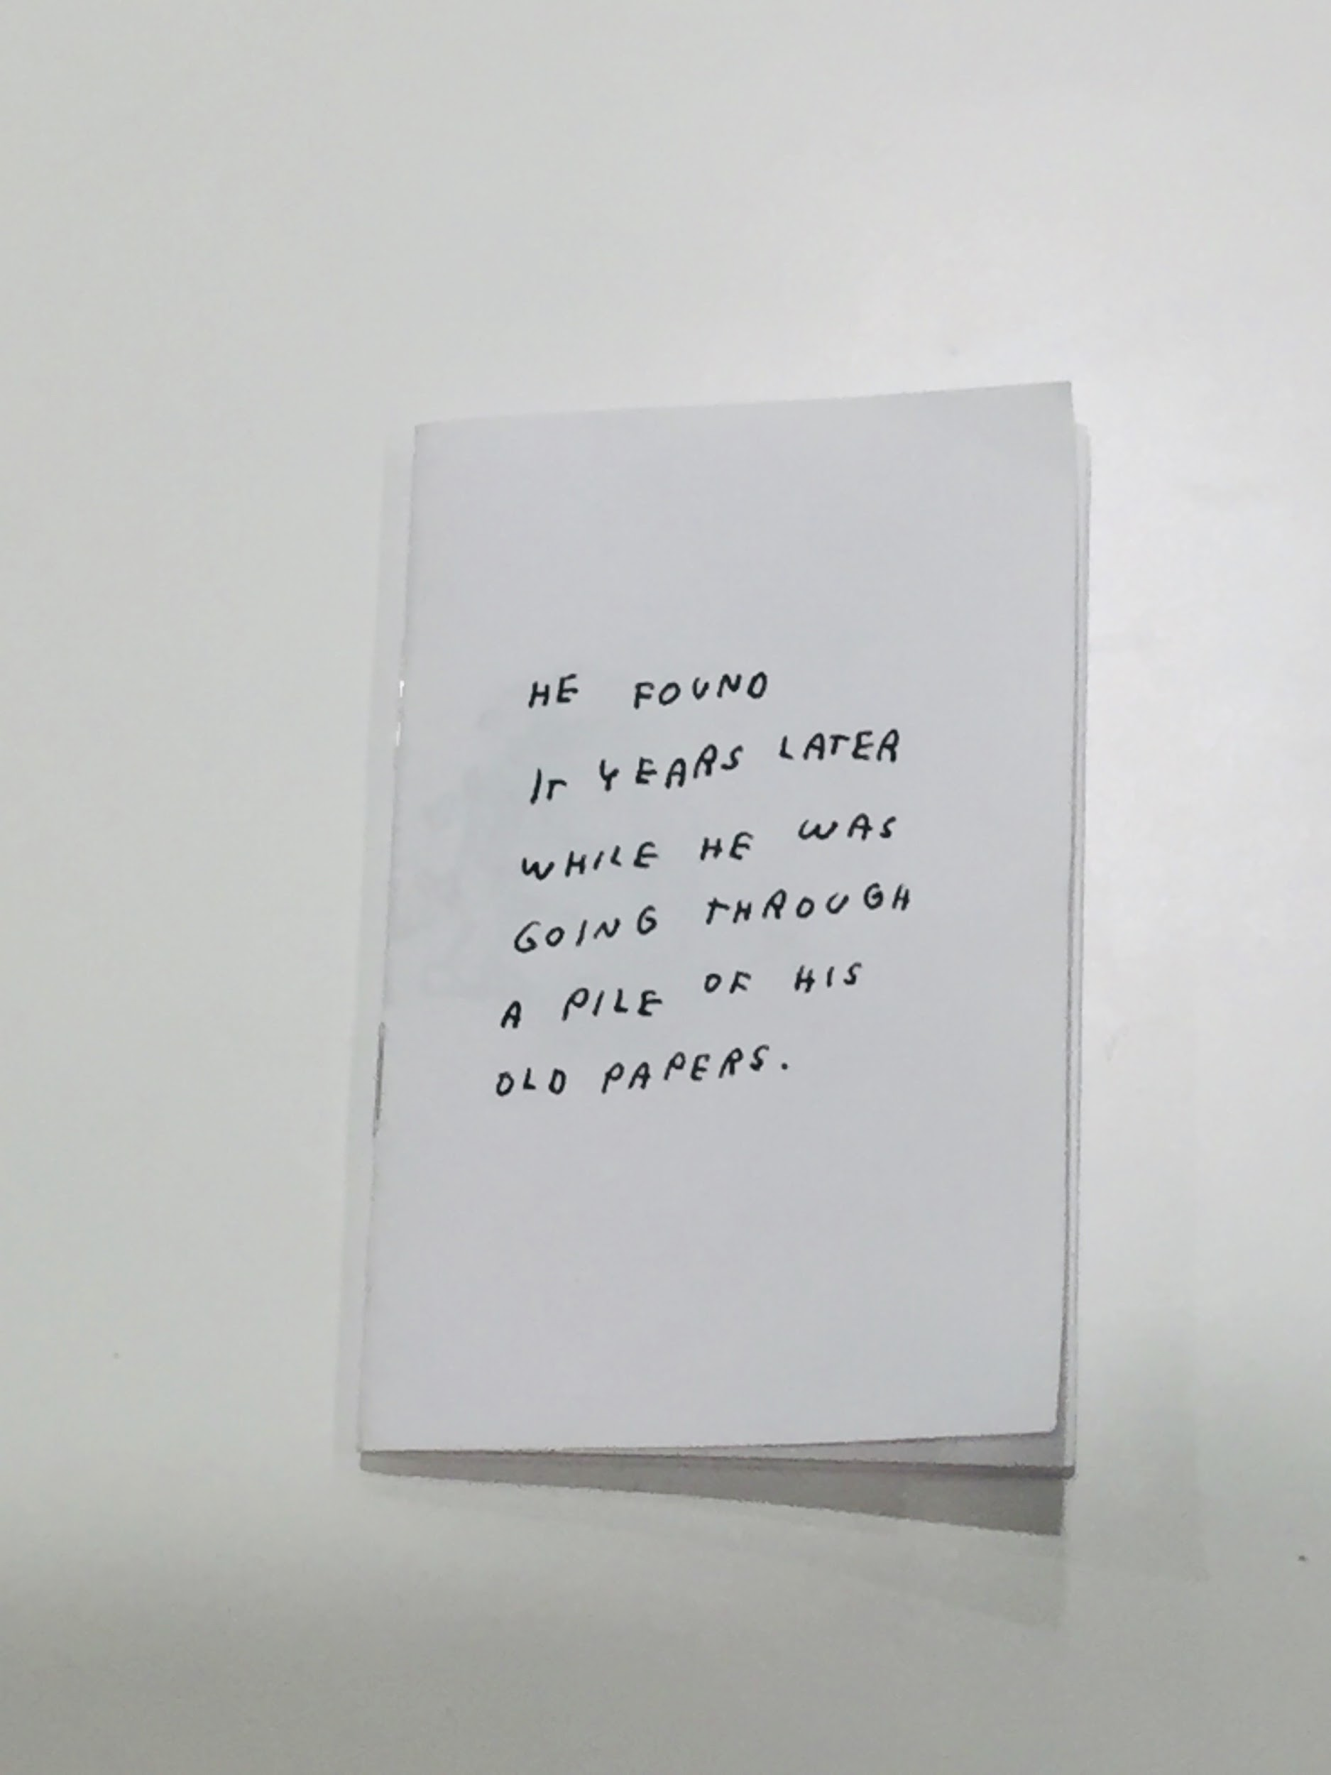
Notes:
He Found It Years Later // Jason Polan
Example of 1 page booklet, but staple-bound verses folded
Also example of a collection of miscellaneous sketches

Slide 25
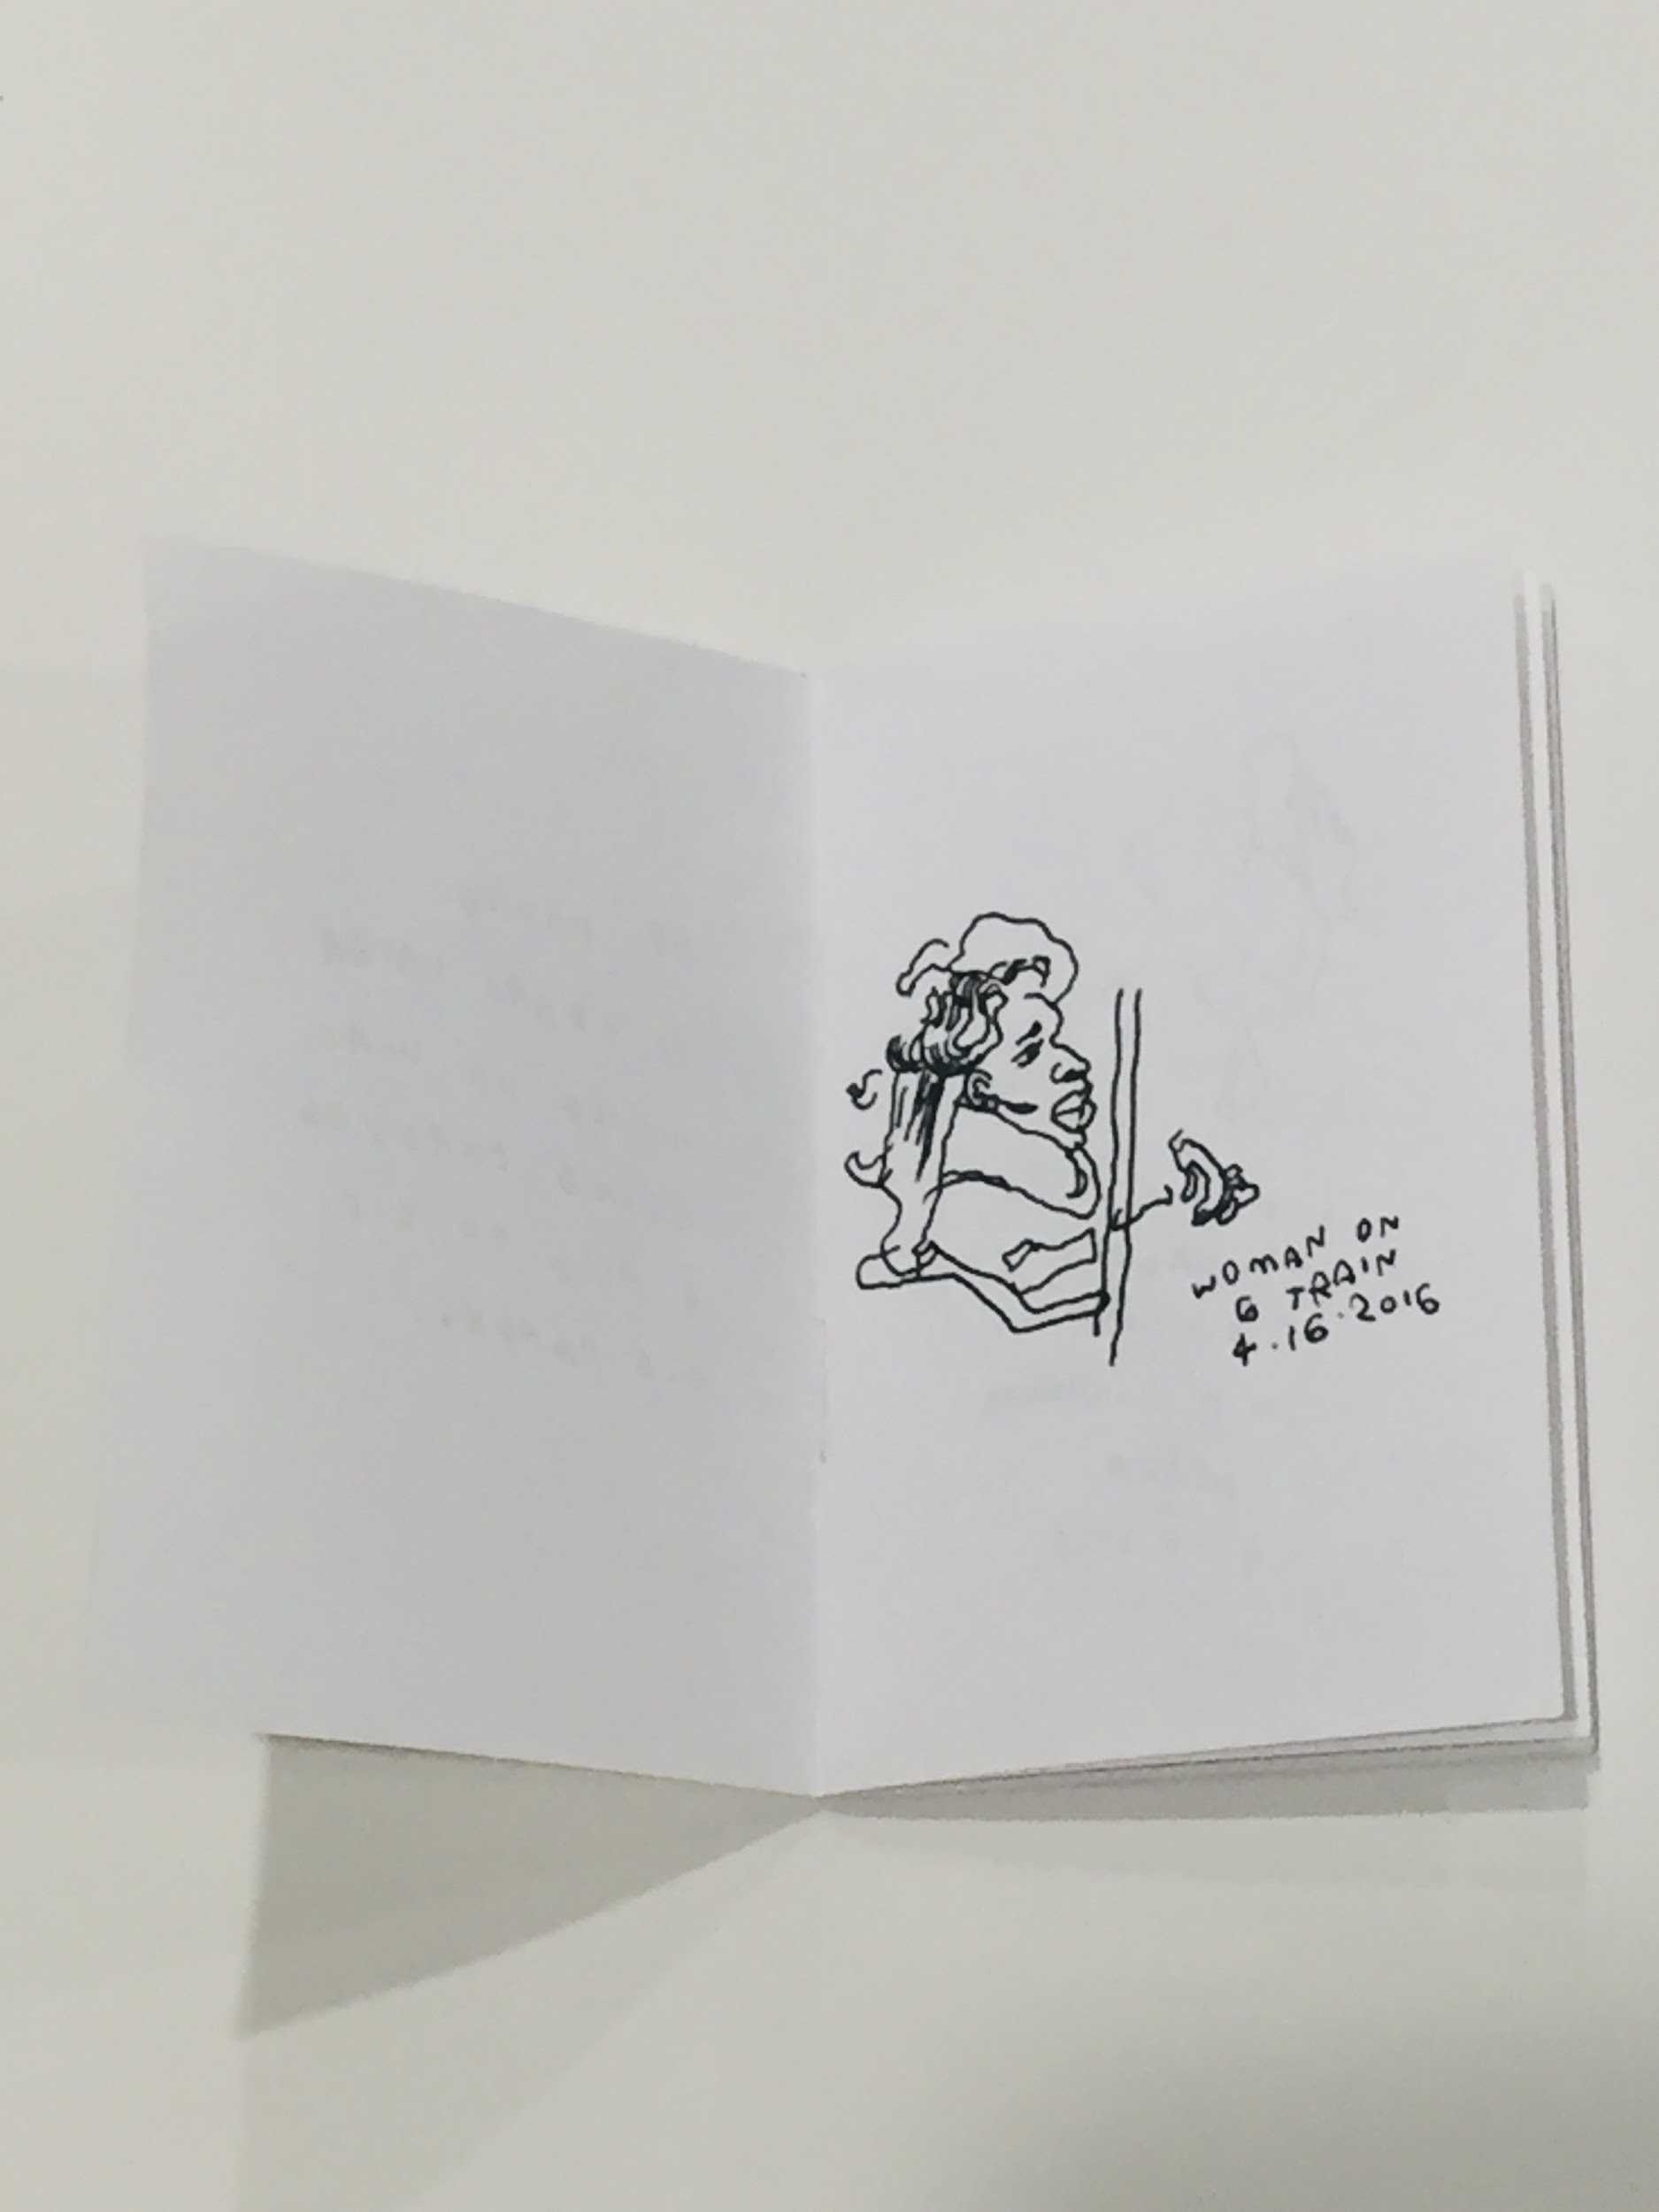
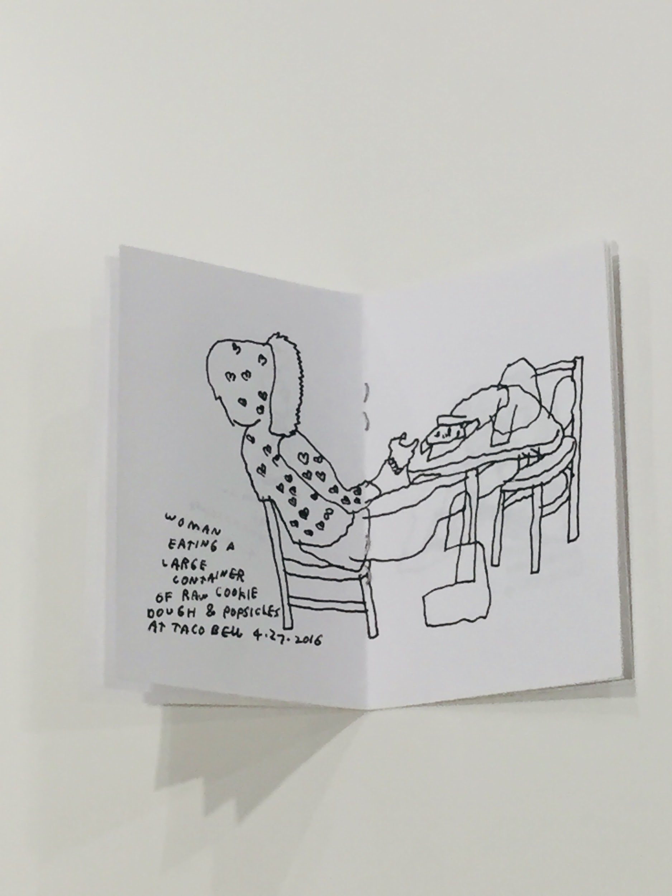
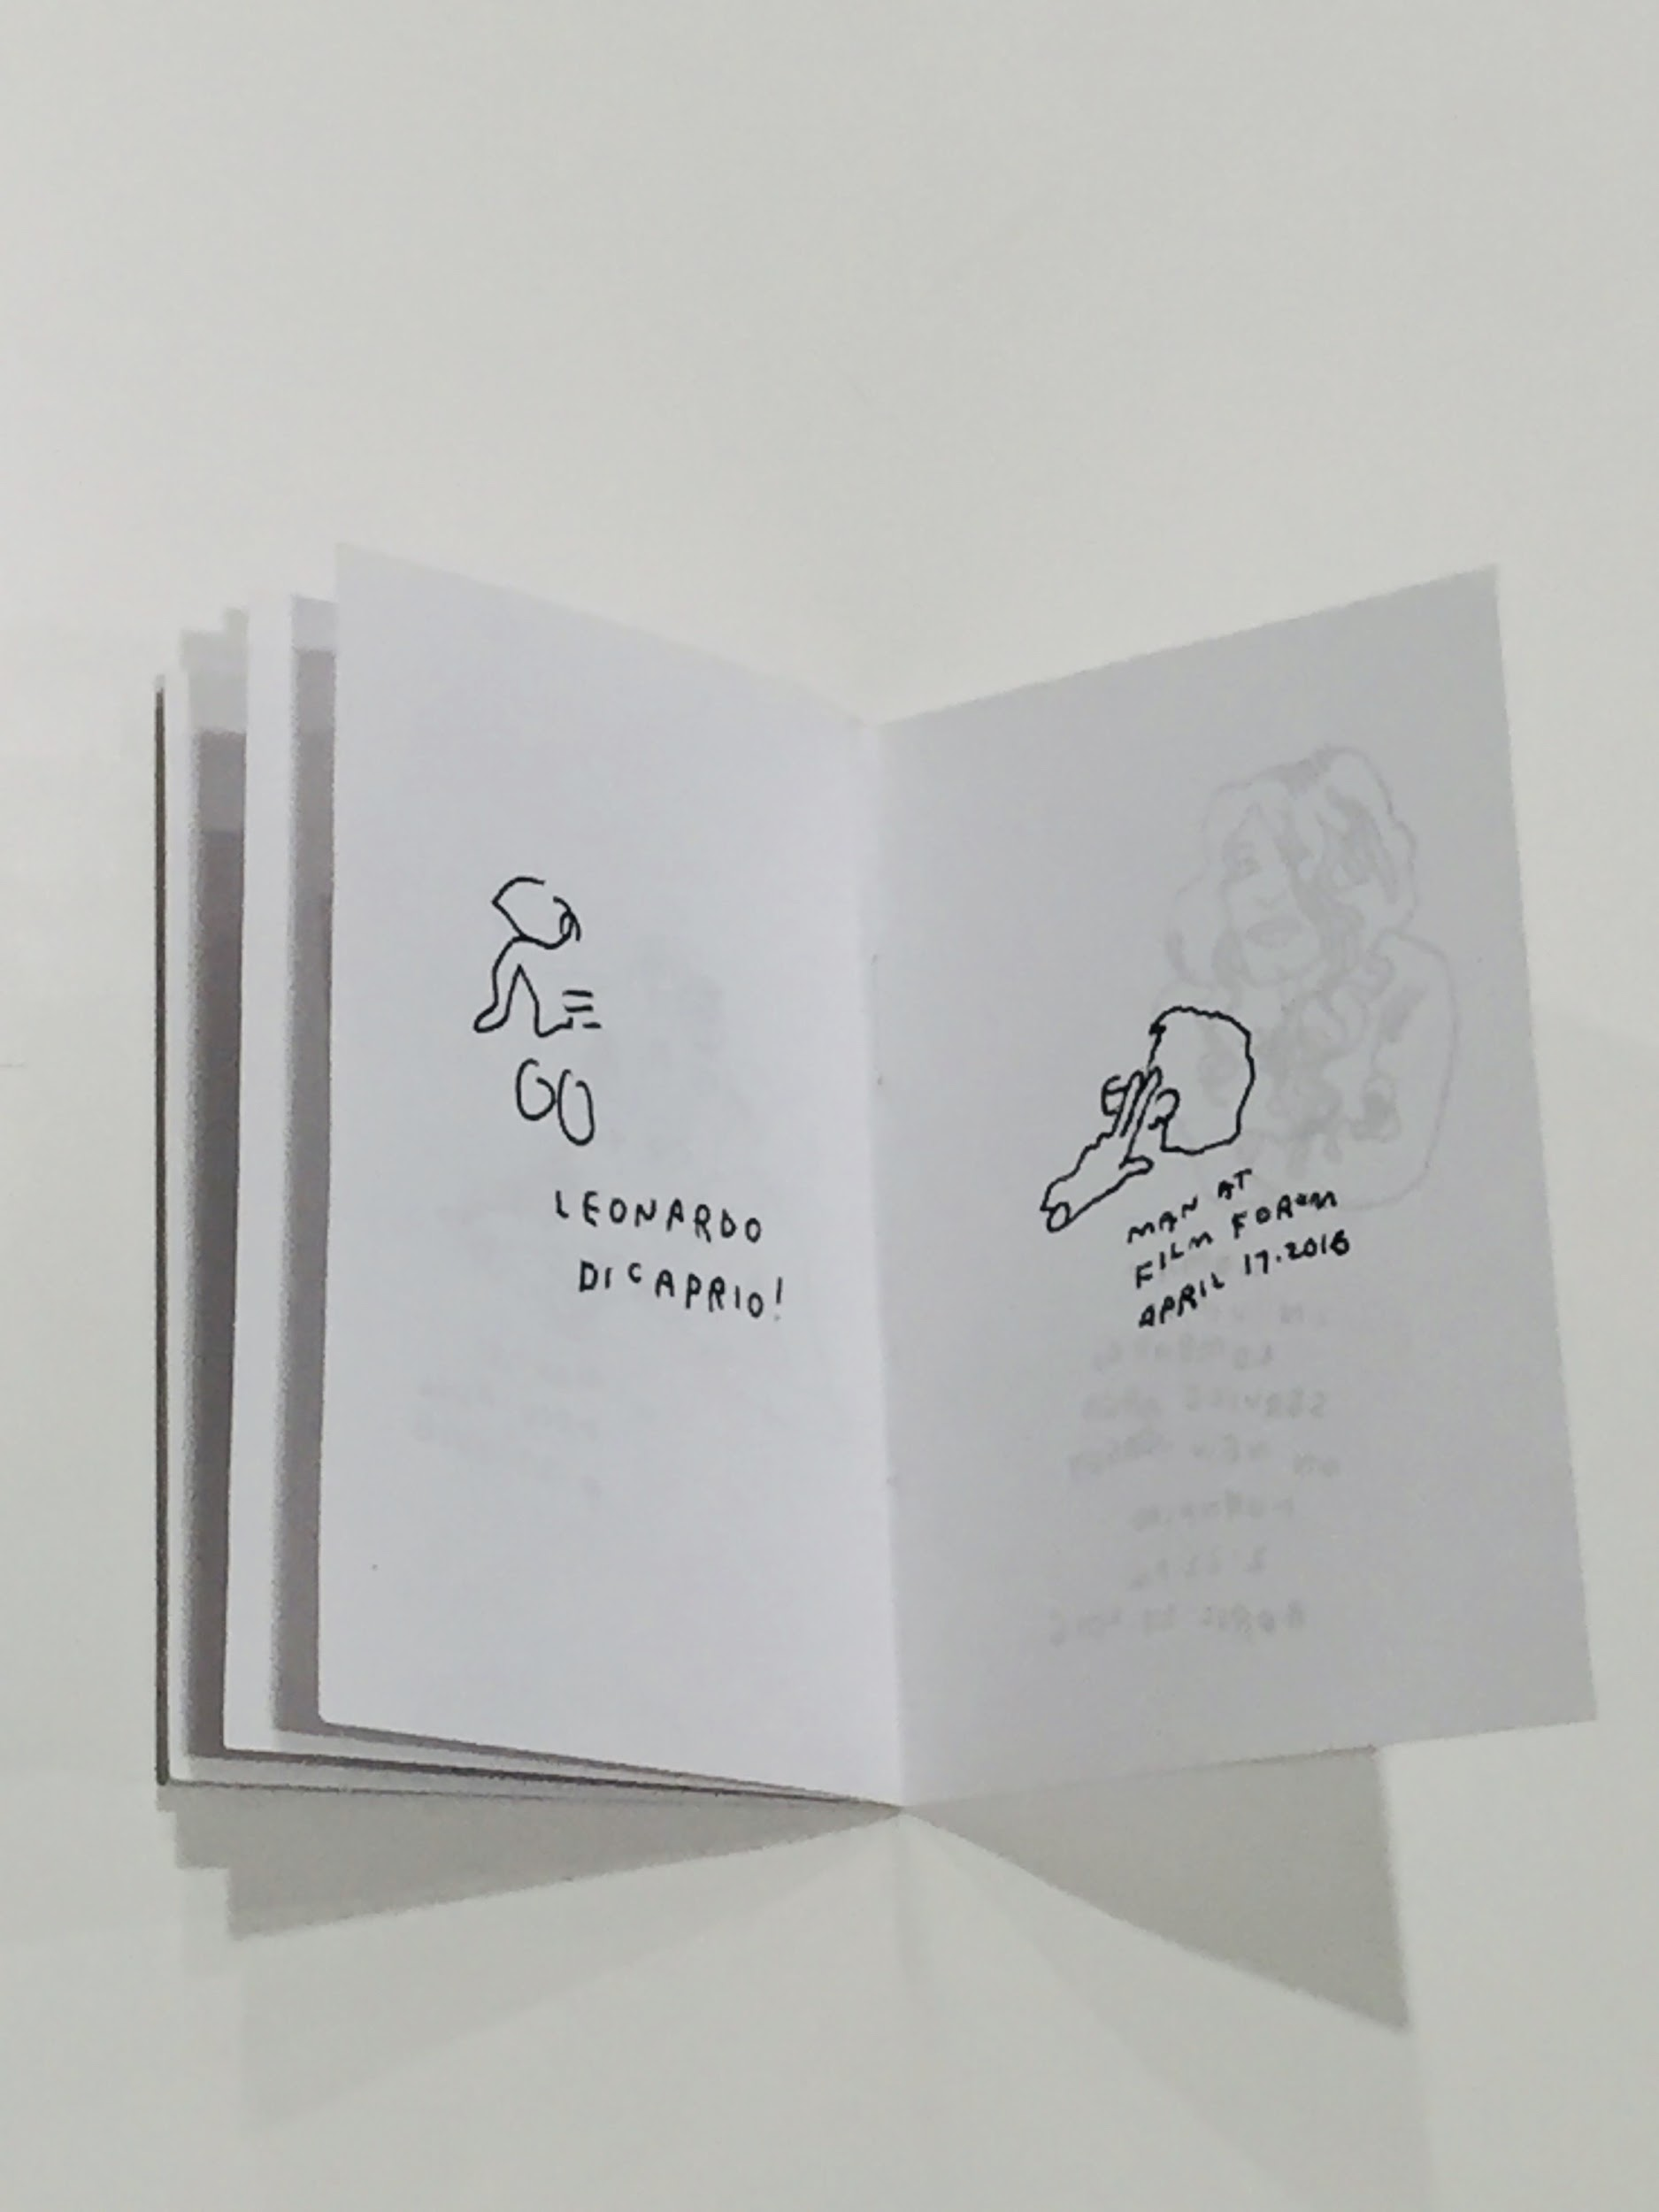
Notes:
He Found It Years Later // Jason Polan
Example of 1 page booklet, but staple-bound verses folded

Slide 26
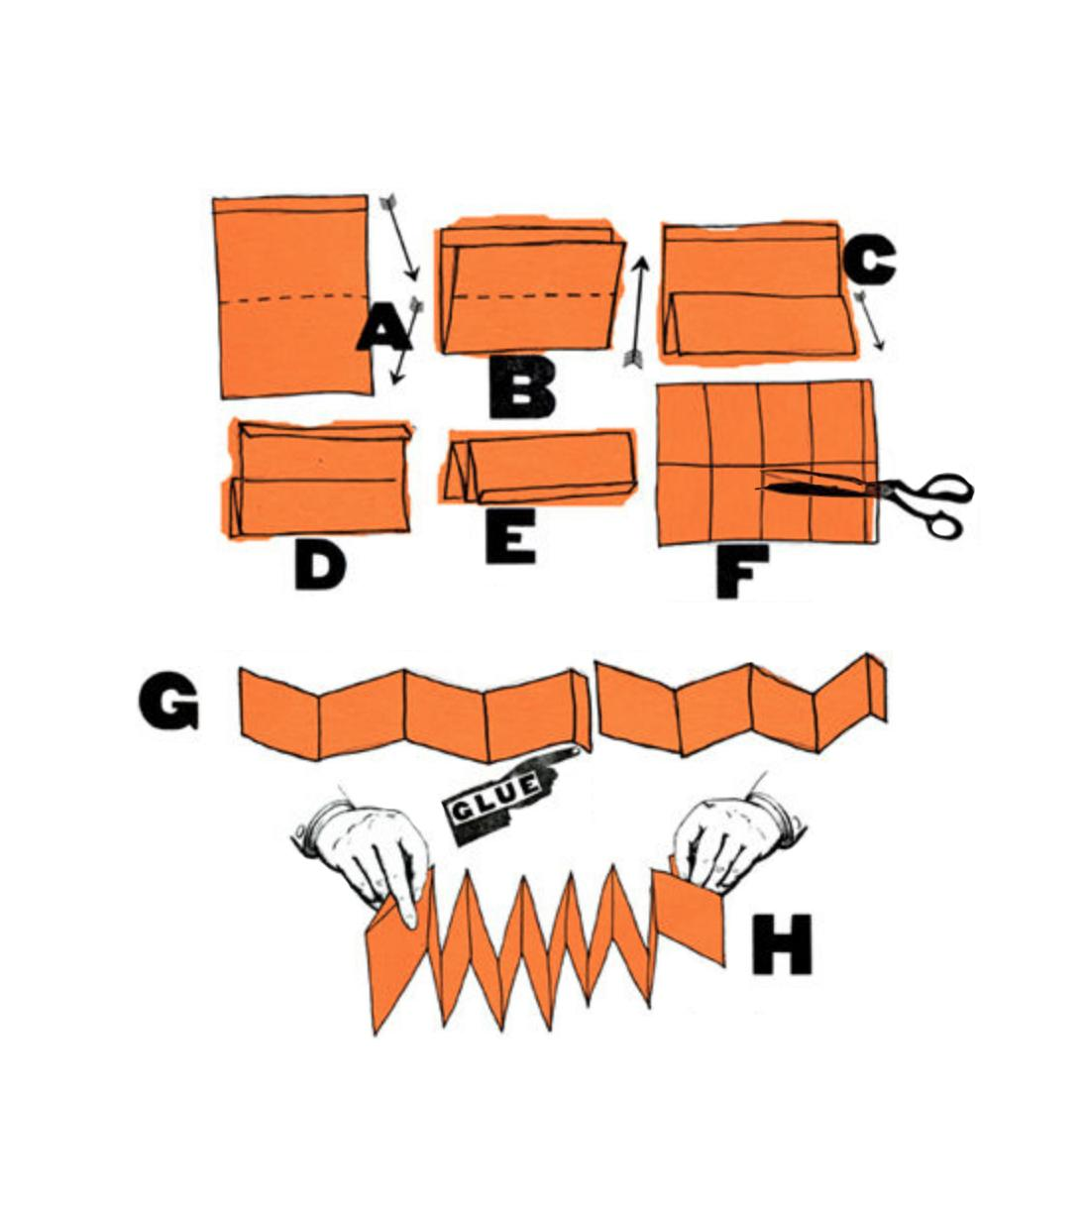
Notes:
Accordion Fold tutorial & images above are adapted from How to Make Books: Fold, cut & Stitch your way to a One-of-a-kind book by Esther K Smith of Purgatory Pie Press
1st image set = creating the Accordion fold pages for inside sketchbook
2nd image set = using an adhesive (double sided tape or glue), secured your sketchbook pages inside your cover

Slide 27
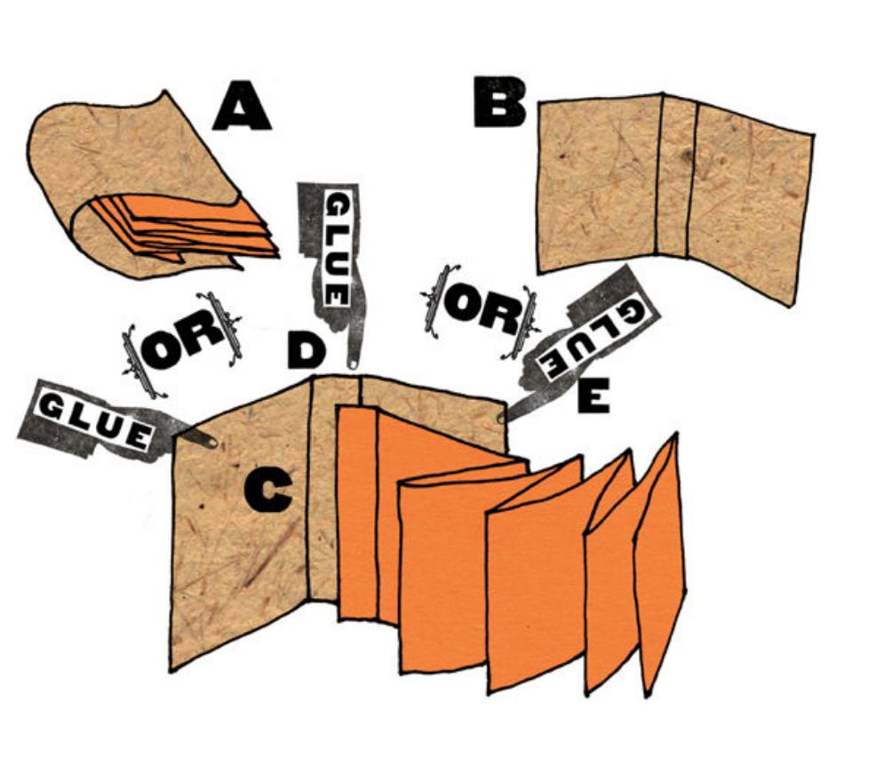
Notes:
Accordion Fold tutorial & images above are adapted from How to Make Books: Fold, cut & Stitch your way to a One-of-a-kind book by Esther K Smith of Purgatory Pie Press
1st image set = creating the Accordion fold pages for inside sketchbook
2nd image set = using an adhesive (double sided tape or glue), secured your sketchbook pages inside your cover

Slide 28
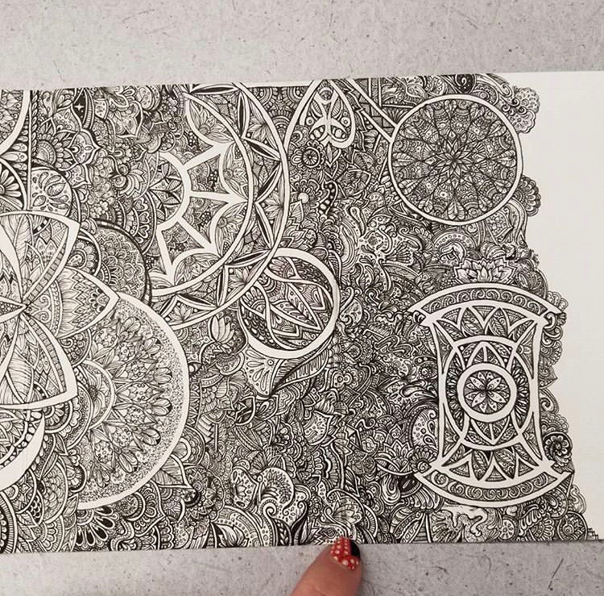
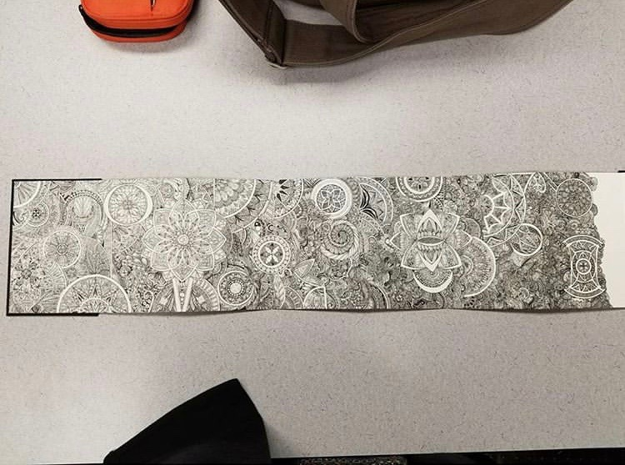
Notes:
@rinnosaurusrex
Example of Accordion fold as great for extended pattern exploration or doodles

Slide 29
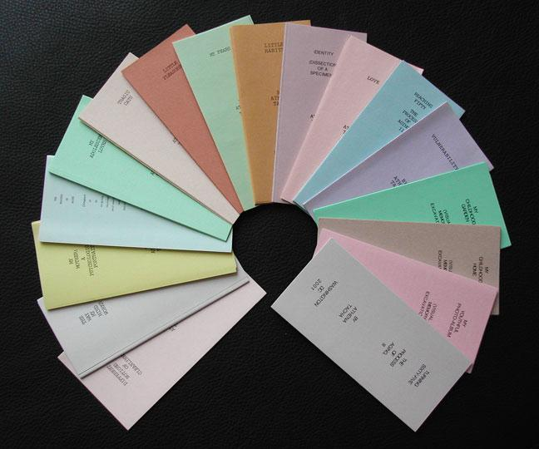
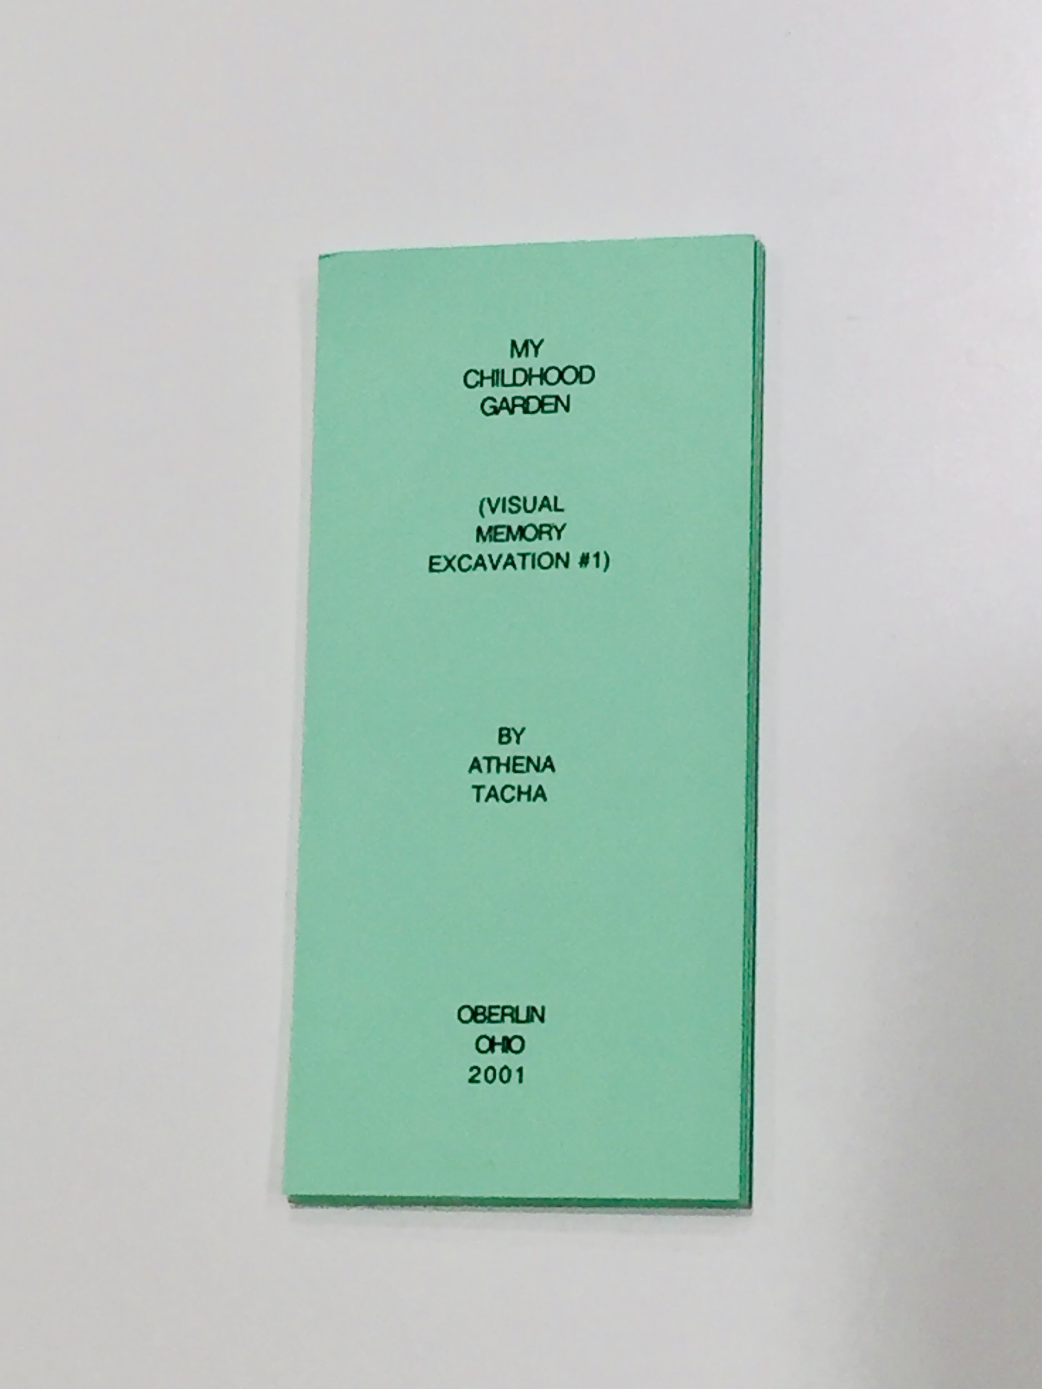
Notes:
My Childhood Garden (Visual Memory Excavation #1) by Athena Tacha // part of her book series
Using an accordion fold as a way to explore a creative writing exercise

Slide 30
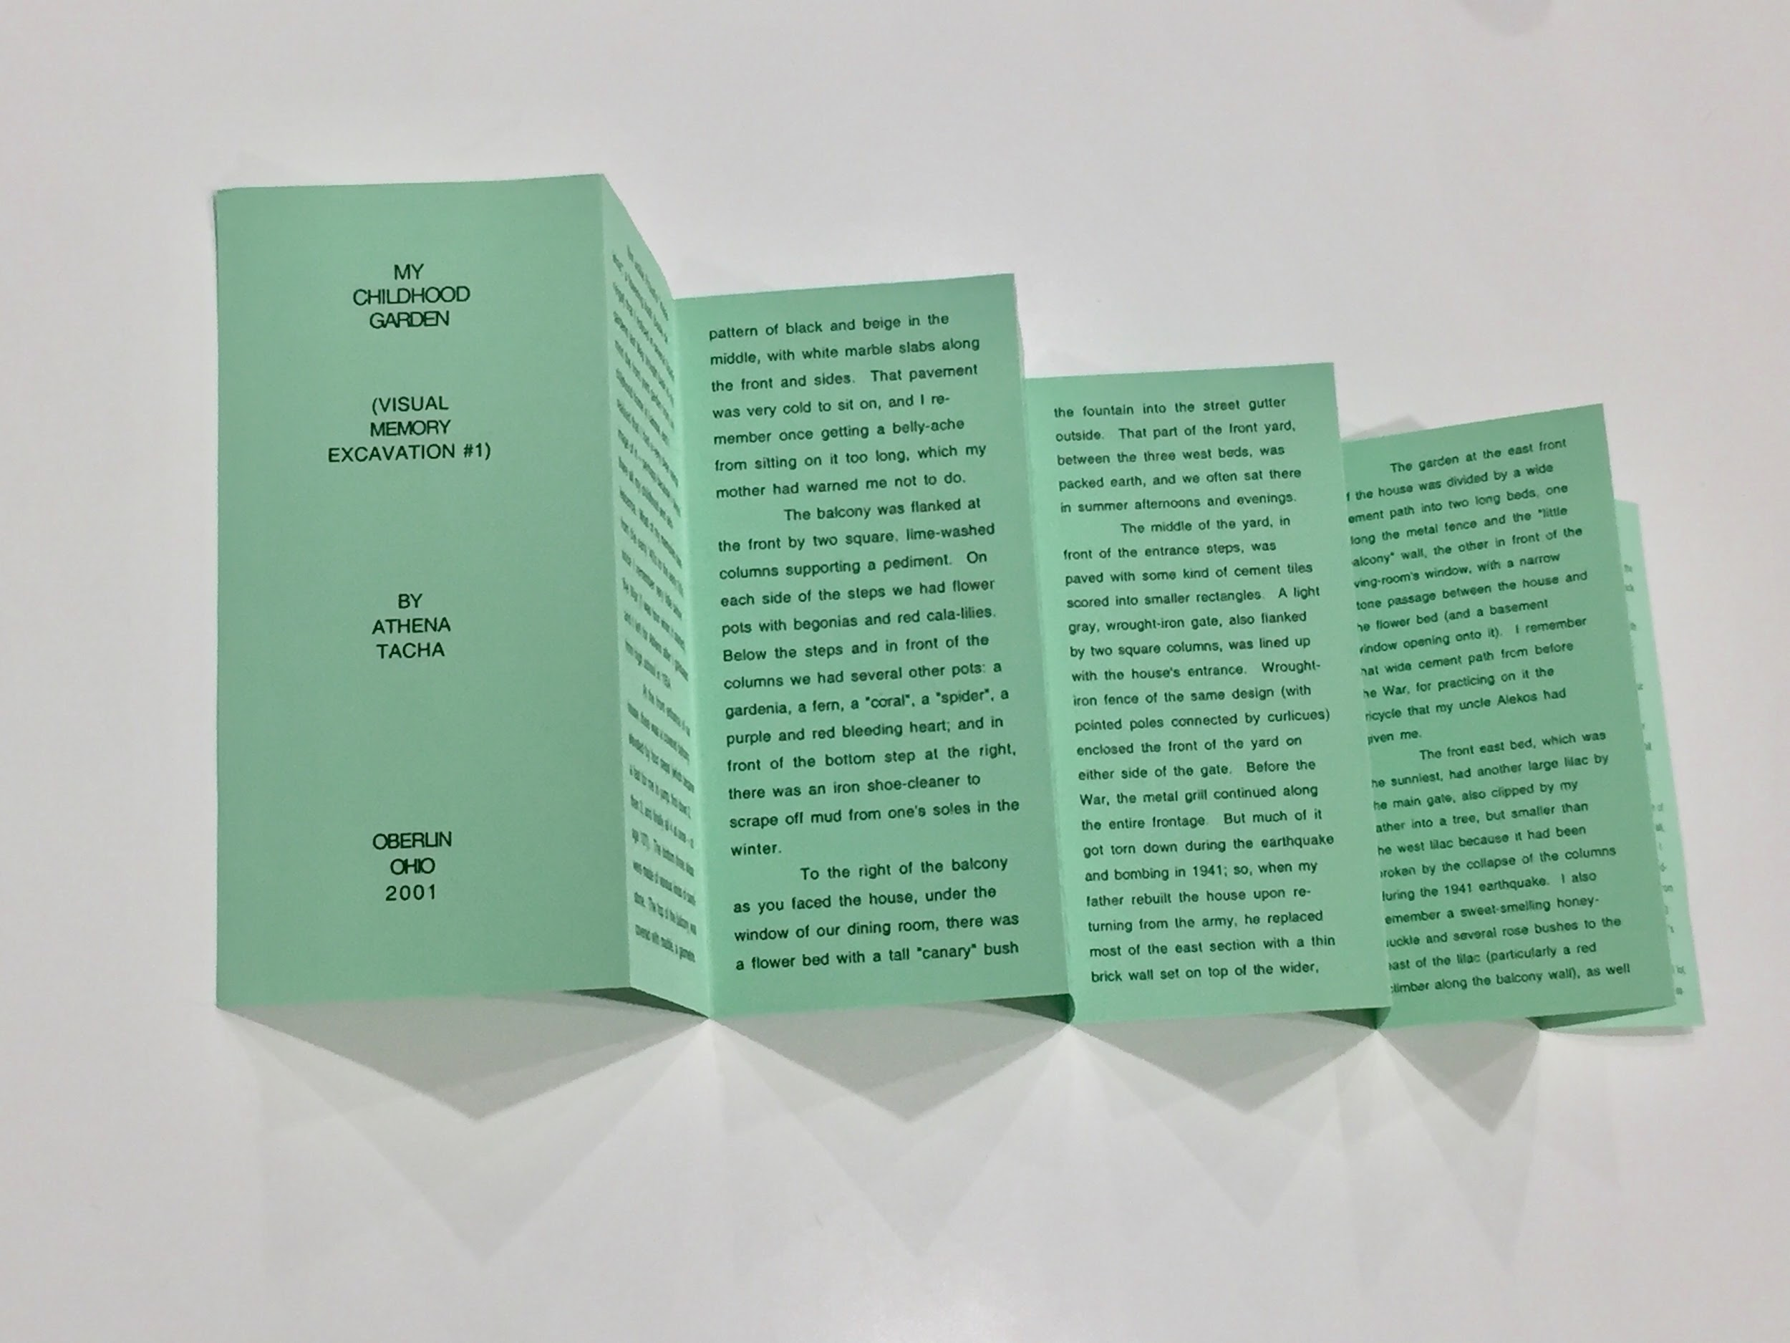
Notes:
My Childhood Garden (Visual Memory Excavation #1) by Athena Tacha // part of her book series
“An attempt to dig out memories to reconstruct through visual information places loved in childhood; our garden and back yard.”
Using an accordion fold as a way to explore a creative writing exercise

Slide 31
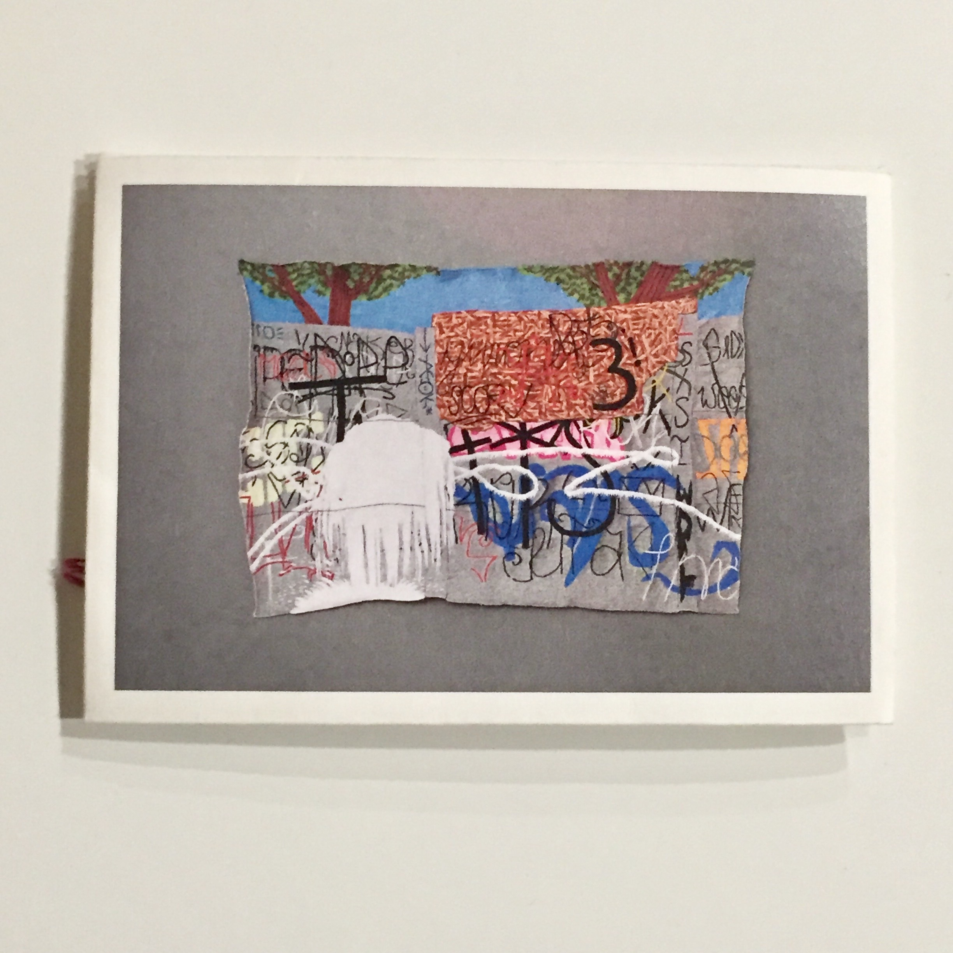
Notes:
Claudia Gutiérrez Marfull // Untitled
Embroidered graffiti images / showing how the 2 sides of an accordion fold can reveal different things

Slide 32
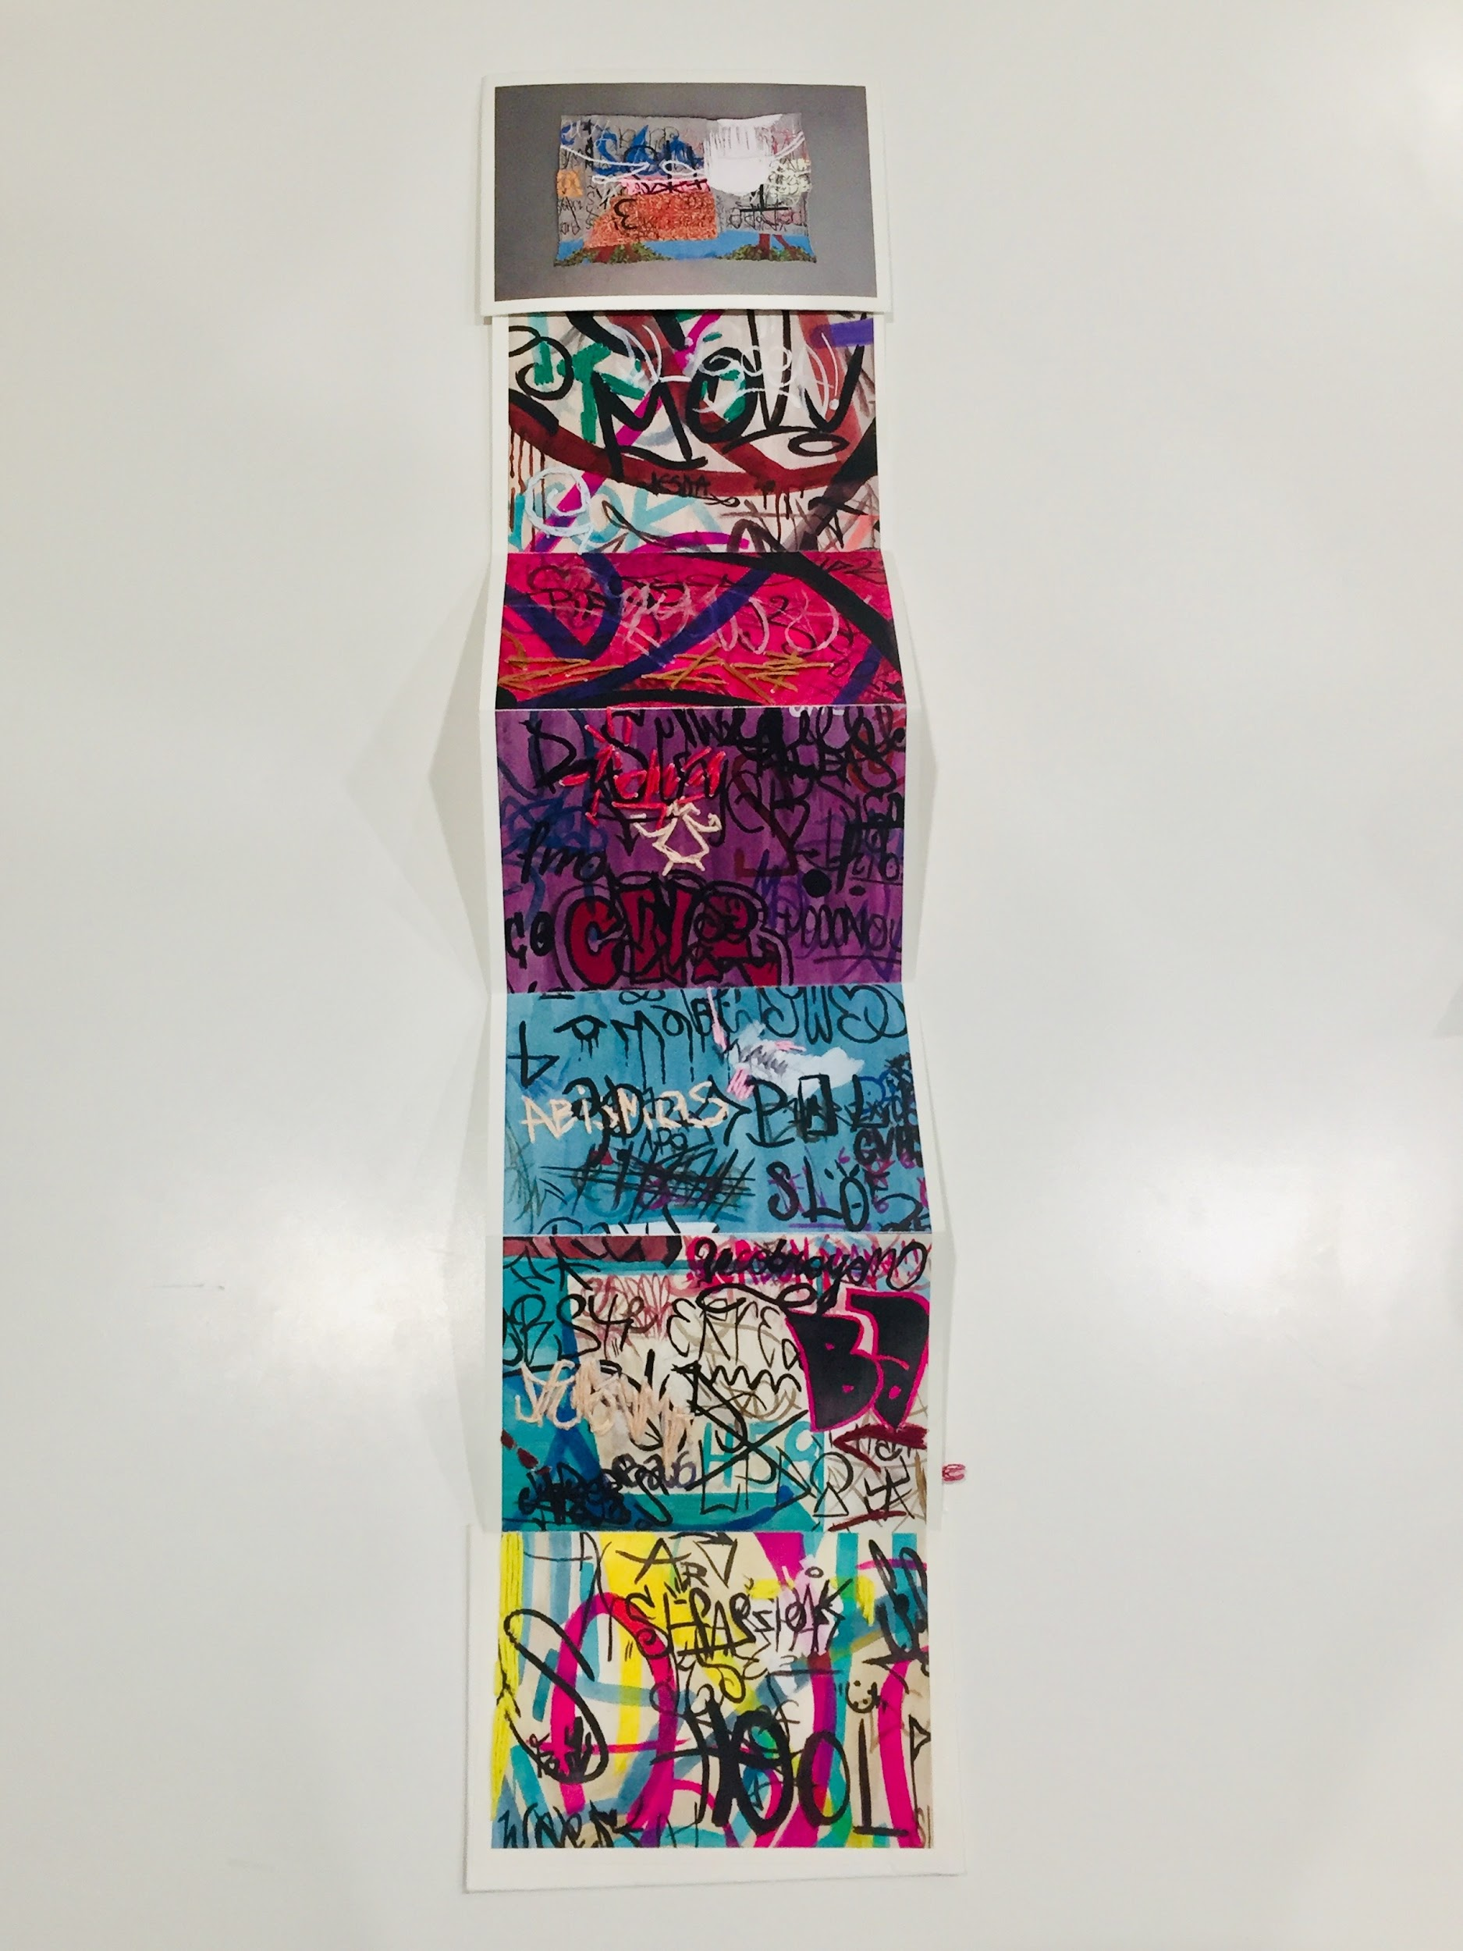
Notes:
Claudia Gutiérrez Marfull // Untitled - Graffiti embroidered Accordion
Using photography and embroidery, thinking of different ways of interacting with our environments & ways of line making

Slide 33
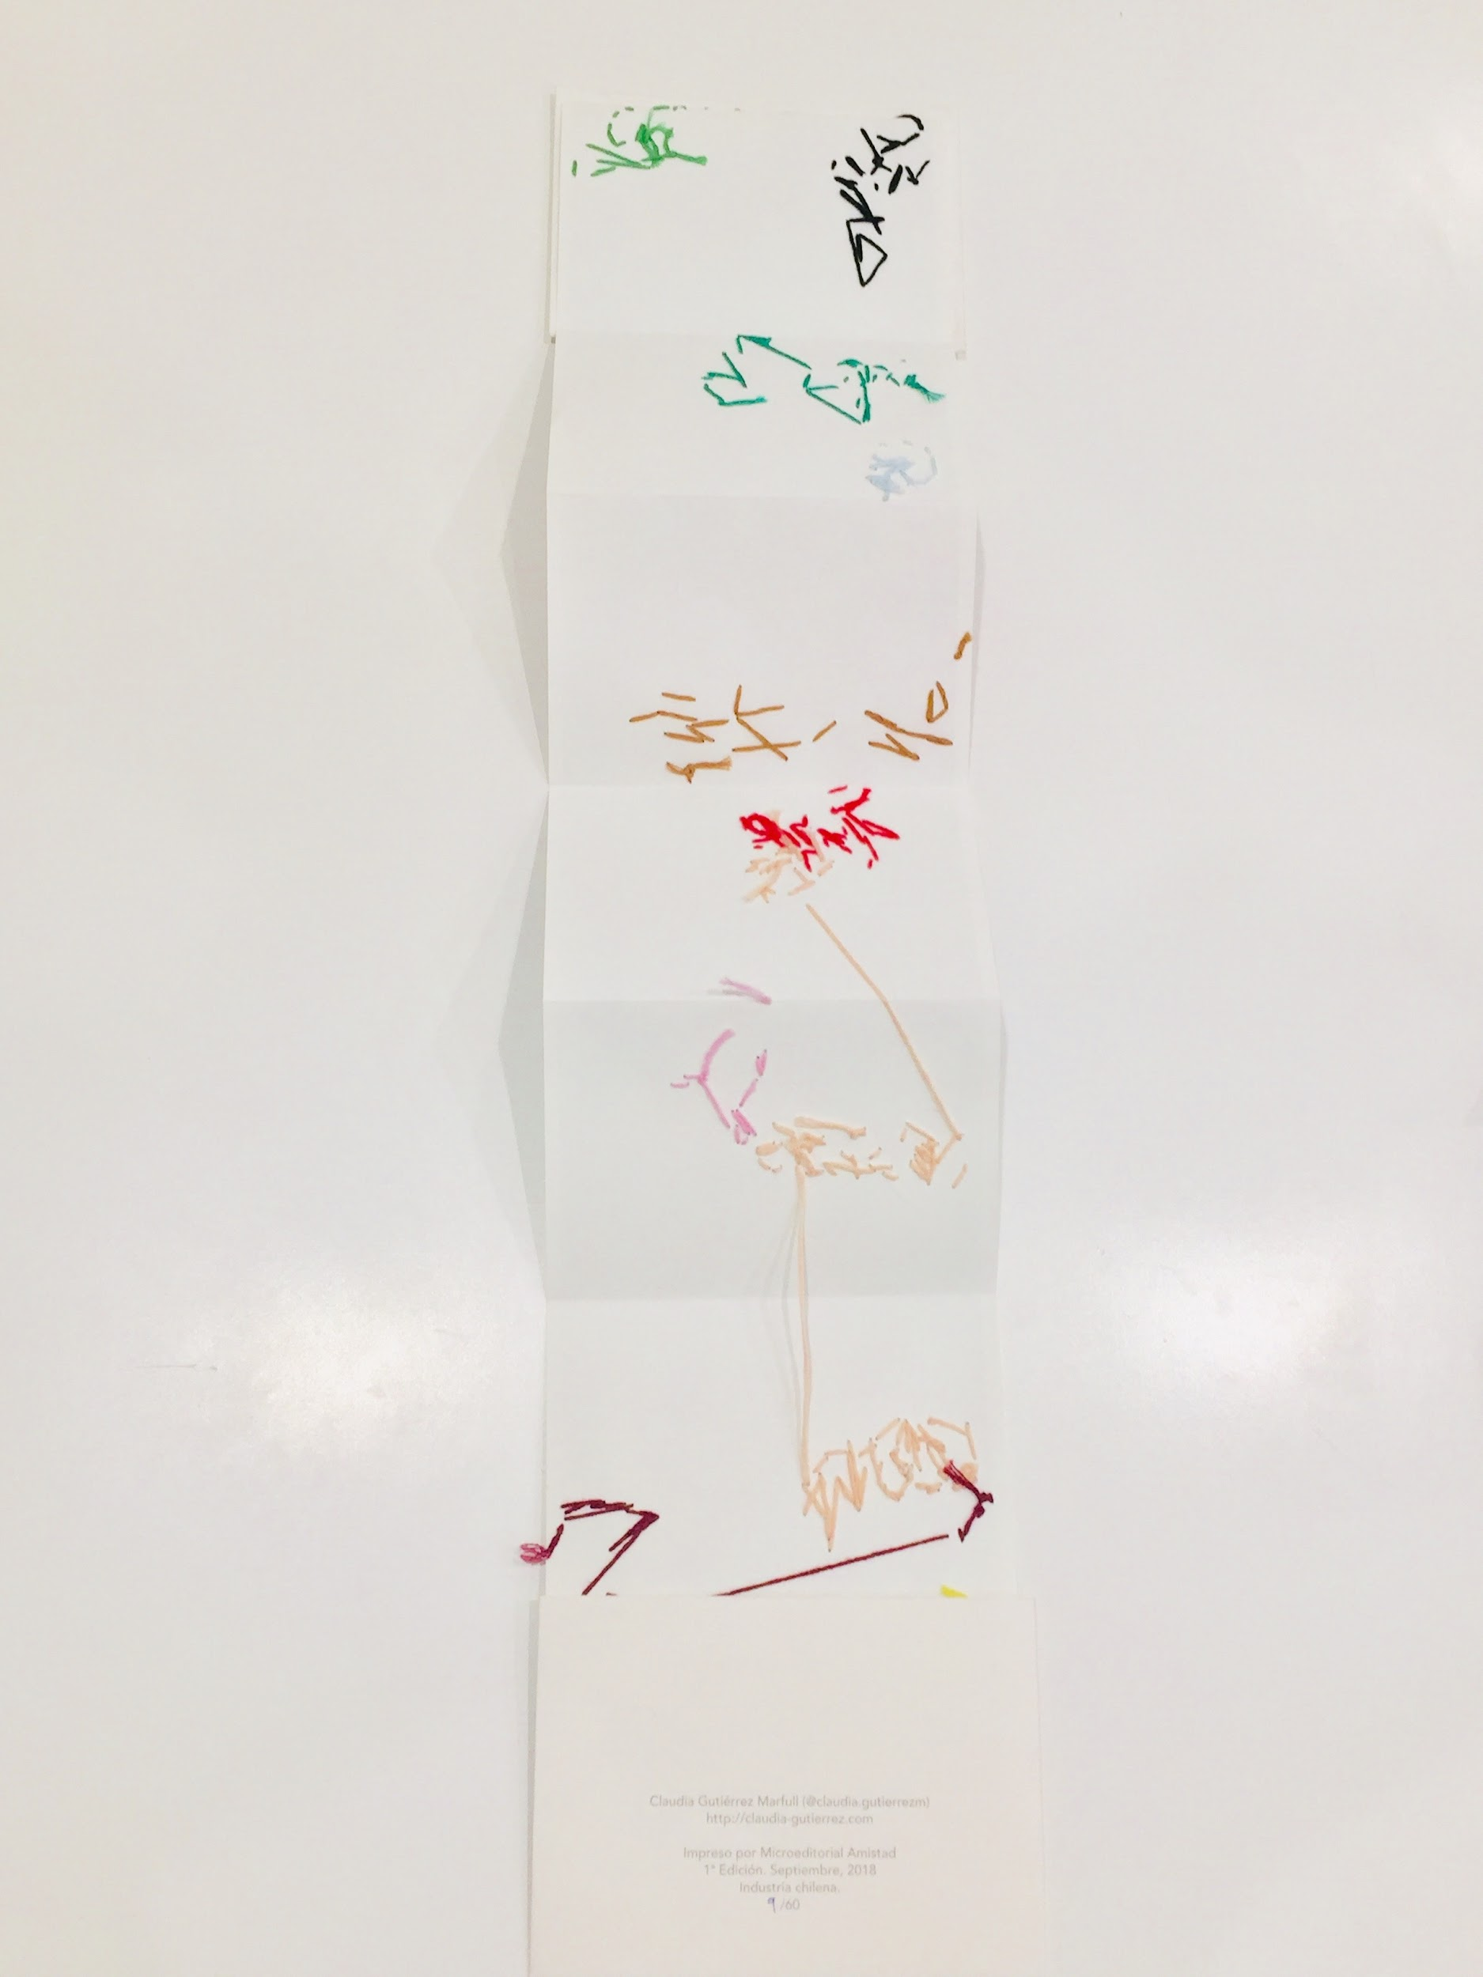
Notes:
Claudia Gutiérrez Marfull // Untitled - Graffiti embroidered Accordion
** how the 2 sides of the accordion can display different kinds of poetic information

Slide 34
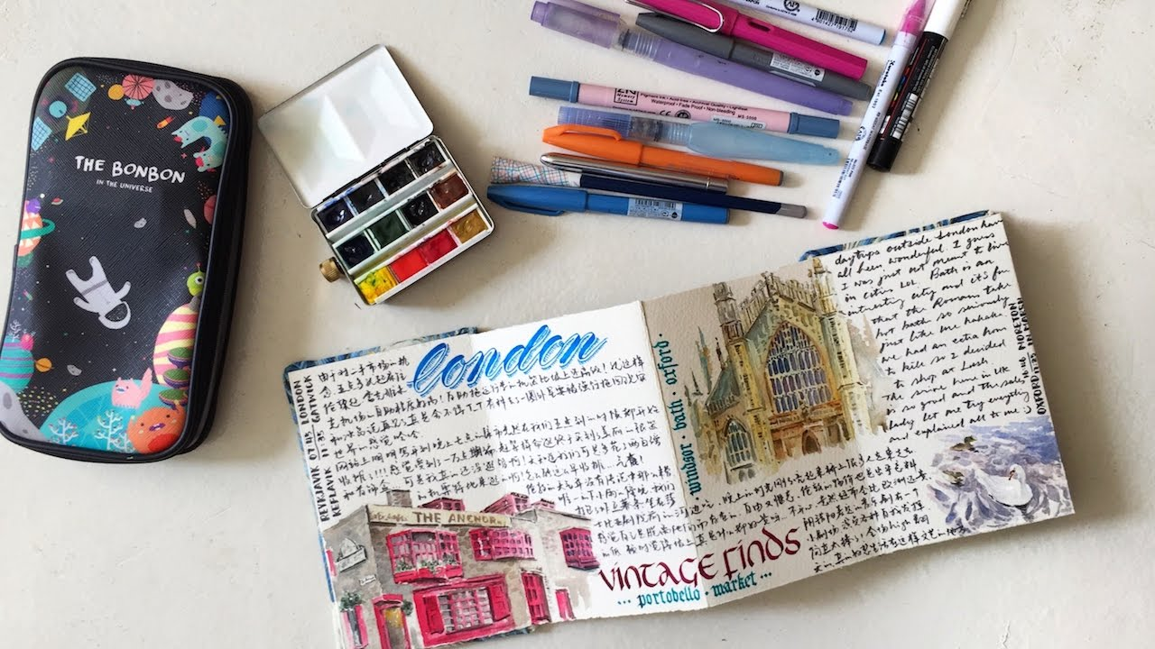
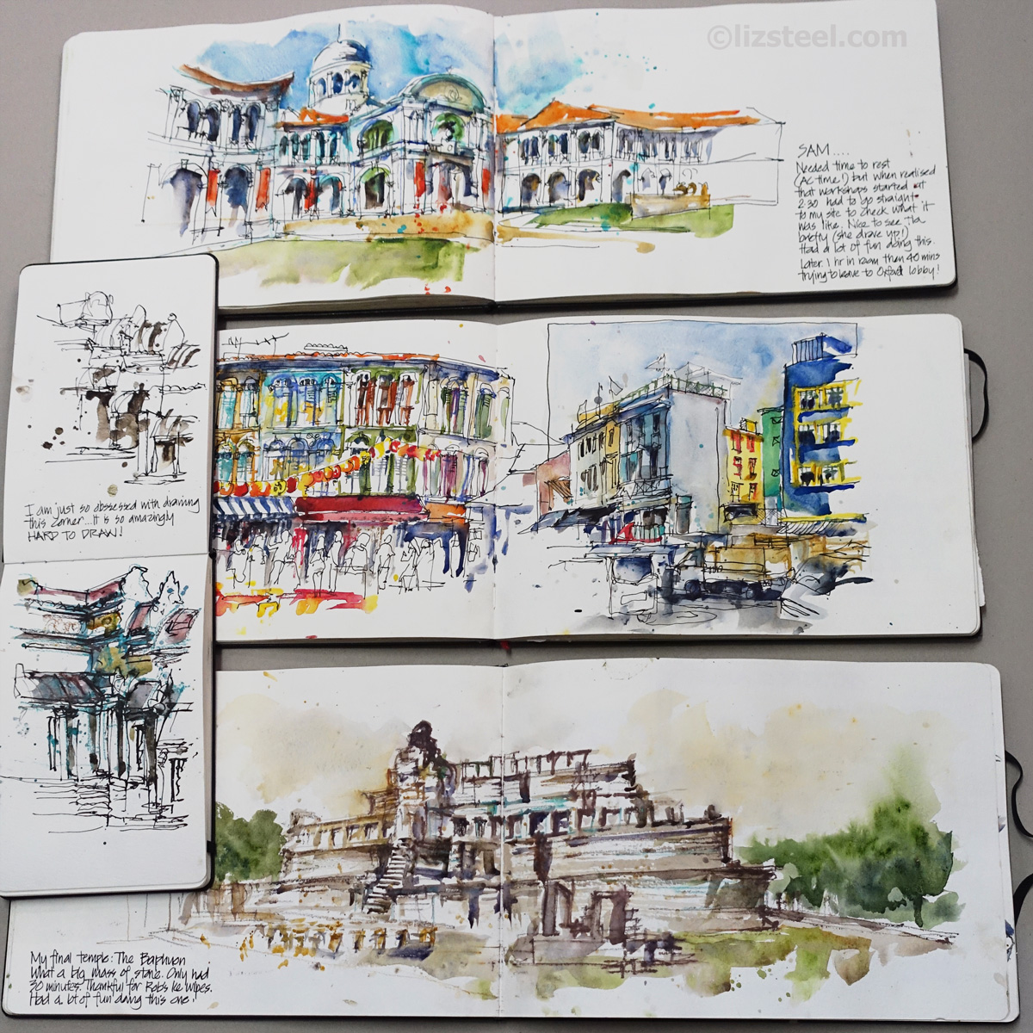
Notes:
Using an accordion to document your travels or a specific allotment of time

Slide 35











Notes:
Other Scales of Prosody by Tanaz Modabber
a sixty-meter-long drawing which was also used in the past as a score, and as a referential mapping.
For te artist, the work also refers to the links between poetry, music, architecture, and politics in Iran.

Slide 36

Notes:
Playing with sequential drawing & animation
Eva chatelain

Slide 37








Notes:
Illustrator Hannah Moog // @h_moog
exploring different qualities of line making: 1 on each side

Slide 38






Notes:
Illustrator Hannah Moog // @h_moog
Exploring/Collecting trends seen through the year

Slide 39

Notes:
Post Uni-Trance [5] by poesveryattractivecousin.wordpress.com [“A list of things I love”]

Slide 40


Notes:
Post Uni-Trance [5] by poesveryattractivecousin.wordpress.com [“A list of things I love”]
Sometimes it can be nice just to brainstorm creatively through lists?
The 2 book forms as a means of quick diy / self publishing

Slide 41


Notes:
Kits on Etsy

Slide 42


Notes:
Pocket bookbinding kit - learn to make two sewn bindings,and two bonus folded mini books
https://www.etsy.com/listing/545424975/pocket-bookbinding-kit-learn-to-make-two?ga_order=most_relevant&ga_search_type=all&ga_view_type=gallery&ga_search_query=pamphlet+stitch+kit&ref=sr_gallery-1-2&organic_search_click=1

Slide 43



Notes:
The Art of the Fold: How to Make Innovative Books and Paper Structures Hardcover – October 2, 2018
Bound: 15 beautiful bookbinding projects
How to Make Books: Fold, cut & Stitch your way to a One-of-a-kind book

Slide 44






Notes:
NY art book fair
Desert Comics
Berl’s poetry Shop
Blue Stocking
Zine Fairs // ex: New York Tech Zine Fair

Slide 45
Draw or write about 3 things from your favorite season -could be a weather season - a food season-ing - favorite tv season
-or any other season that speaks to you?
Notes:
Give an optional prompt while people decorate their covers? Or need help with other steps? A way to activate the sketchbook and help alleviate fear of the blank page
Other prompts for attendees on their own?:
Tracking your dreams / (reference to Data slide)
Follow a specific color (like cerulean blue) through your daily commute or walk home
Use an accordion to document a trip or a specific duration of time
Use an accordion to explore a word pair, with 1 word on one side and the back as the other ex: Day & Night
Collection of haikus
A collection of recipes

Slide 46


Notes:
For more about ideation / visual inspiration as a creative process, check out Idit Barak’s workshop after this
“Inspiration as a tool in the Creative Process”

